Slide 1
Sound Decision-Making : Into the Mind of the Decision-Maker
SOAR Conference
November 7, 2013
By Lilian Ma
Social Justice Tribunals of Ontario

Slide 2
Video #1

Slide 3
So what did we learn?
You missed the gorilla when you watched the ball
Principle #1
The data are never wrong, but your attention controls what reaches your brain

Slide 4
Wht s mssng does nt reely mater becus yu cn stil figre out wht is thre

Slide 5
The brain is highly associative
It associates the data coming in with our prior knowledge/memory

Slide 6
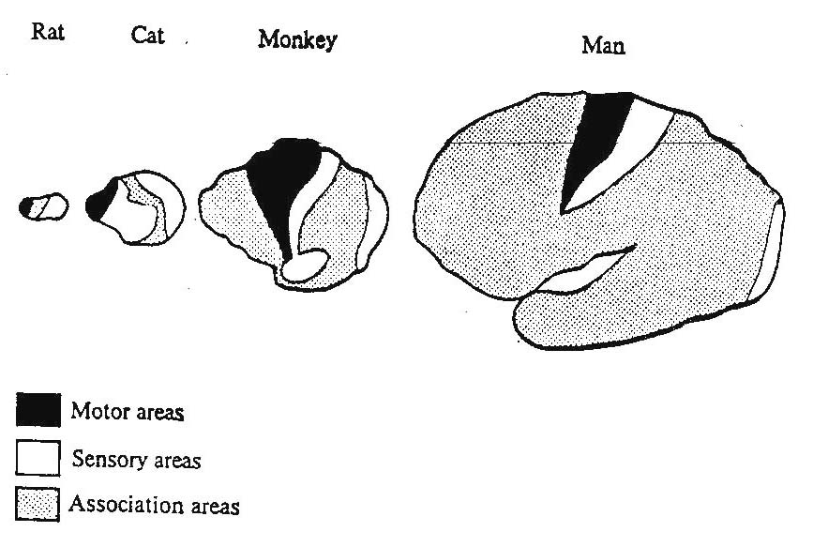

Slide 7
Principle #2
Data allowed in from sensory information at the instant + associated prior knowledge
= our perception
Our perceptions make up our finding of facts

Slide 8
INPUT BRAIN
THINKING (PERCEPTION) DECISION

Slide 9
Retained Prior Knowledge = Memories
What are memories?
They are learned
We store them in SYNAPSES!

Slide 10
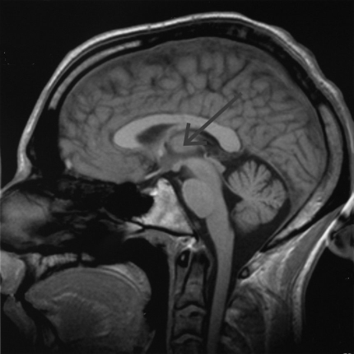
Brain Diagram
Neocortex
Old Brain
Spinal Cord

Slide 11
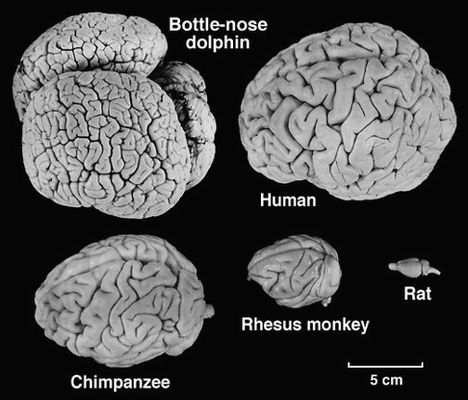
Mammal Brain Sizes

Slide 12
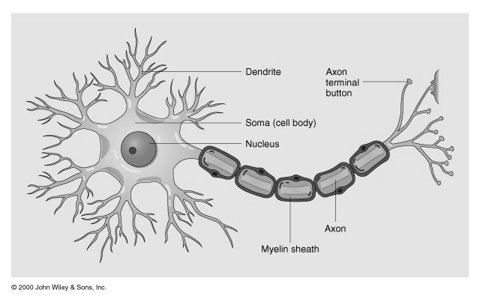
Diagram of Neuron, Axon + Synapses
Image of neuron

Slide 13
Three Important Features for the Neocortex
Mountcastle 1978 postulated basic operation for the neocortex is the same irrespective of where the sensory input originates. The data comes into the neocortex as patterns for processing

Slide 14
Three Important Features for the Neocortex (cont.)
The wiring of the neocortex is very plastic, meaning it can change and rewire itself given what input flows through them, or just fade over time

Slide 15
Three Important Features for the Neocortex (cont.)
Hierarchy of the arrangements of the connections leading to memory – prediction framework
Input + Memory (prior knowledge) = Prediction
THEREFORE HUMAN INTELLIGENCE

Slide 16
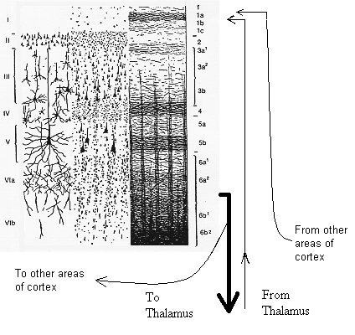
Hierarchy
Diagram

Slide 17
Learning is Enhanced by
Repetition
In the Mood
Frequent Revision

Slide 18
Deciding
To have an impartial and unbiased disposition
To examine the evidence presented at the hearing and weigh them
To determine the facts based on the weighted evidence
To apply the law and make a rational decision
This assumes we are logical machines but it did not take into account how the human brain works

Slide 19
Fast and Slow Thinking Two System Model (Daniel Kahneman)
System 1 – Fast Thinking
Intuitive and Emotional
Allows us to jump to conclusions
System 2 – Slow Thinking
Deliberate
Rational Thinking

Slide 20
Uses of Slow Thinking
Resolving Ambiguity
Helps to reach the correct conclusion

Slide 21
Uses of Slow Thinking (cont.)
2. Becoming Aware of Personal Bias
Keeps an “open mind”
Allows parties to get a fair and impartial hearing

Slide 22
Uses of Slow Thinking (cont.)
3. Avoid Emotional Decisions
High emotion evokes System 1
Suppresses System 2 thinking

Slide 23
Uses of Slow Thinking (cont.)
4. Tackling the Difficult Questions
Hard Work
Sometimes System 1 may take over
Anchoring effect

Slide 24
Uses of Slow Thinking (cont.)
5. Depletion Effect
If fatigued, will most likely be making a decision in System 1
Study reported by the Proceedings of the National Academy of Sciences was done on eight parole judges

Slide 25
Uses of Slow Thinking (cont.)
6. Institutional Influences
Our opinions can be moulded by the way we are trained
Discussions laid out in e.g. Consolidated Bathurst which are allowed and encouraged

Slide 26
Deciding
By Lilian Ma
Wisdom knows that data are never wrong
Memories are forever ‘til they are gone
Human intelligence or human error - our brain has the say
Deploy fast and slow thinking to make your day

Slide 27
Video #2

Slide 28
Thank you to
Assistants
Anne Loay
Jamieson Leitch
SJTO

Slide 29
Quickly jot down your answers to the following three questions:
1. How has your understanding of the brain changed, if at all?
2. How secure is your belief that we are rational beings that make sound decisions?
3. What effect, if any, do you think your intuitions, beliefs and/or emotions might be having on your decision-making?
Take five minutes to reflect on these three questions and please hold your thoughts—you will have time later in the session to comment and ask questions.

