Slide 1
WORKSHOP #5
Cultural Competency – The Five W’s

Slide 2
Objectives
Context for cultural competency -- How do we become culturally competent
How does it apply to decision making (from various roles)
Practical approaches to increase cultural competency

Slide 3
Agenda
Introductions and Warm Up
Panel Presentation
Moderated Conversation
Questions and Answers

Slide 4
Say the Colour
PURPLE | YELLOW | RED
ORANGE | GREEN | BLACK
GREEN | BLUE | ORANGE
BLACK | RED | GREEN
YELLOW | BLUE | ORANGE
BLUE | RED | PURPLE

Slide 5
Say the Color
YELLOW | BLUE | ORANGE
BLACK | RED | GREEN
PURPLE | YELLOW | RED
ORANGE | GREEN | BLACK
BLUE | RED | PURPLE
GREEN | BLUE | ORANGE

Slide 6
Panel Members
Moya Teklu
Gary Yee

Slide 7
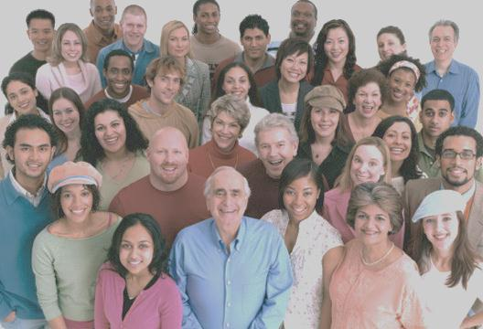
Questions ?

