Slide 1
Social Media and Digital Evidence: Evolution or Revolution
  John GREGORY, Ministry of the Attorney General (Ontario)

Slide 2
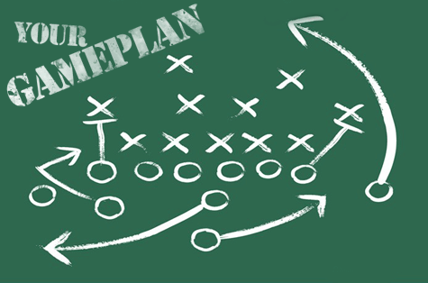
Social Media
4 scenarios
For each scenario:
  Scenario + questions
  Group work
  Discussion

Slide 3
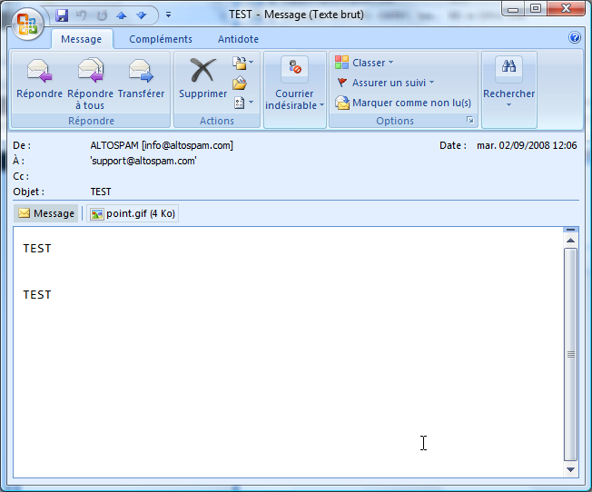
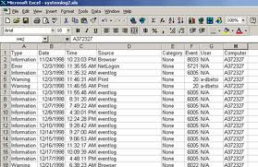
1st scenario
During a hearing, a party wants to produce electronic evidence: an e-mail and an Excel file.

Slide 4
Questions
What will you accept:
  The original electronic document?
  A PDF file of the original electronic document?
  A printed copy (paper) of the original electronic document?
What will you have to verify about the document? How?

Slide 5
1. What will you accept?
The original electronic document?
A PDF file of the original electronic document?
A printed copy (paper) of the original electronic document?
and why?

Slide 6
2. What will you have to verify about the document?
How ?
Reliability compared to paper

Slide 7
Discussion
Integrity in the technological world (metadata)
  How to assure integrity and authenticity?
  How to demonstrate integrity?
  Difference between electronic document and paper document (example with an e-mail and an Excel file (calculation functions)

Slide 8
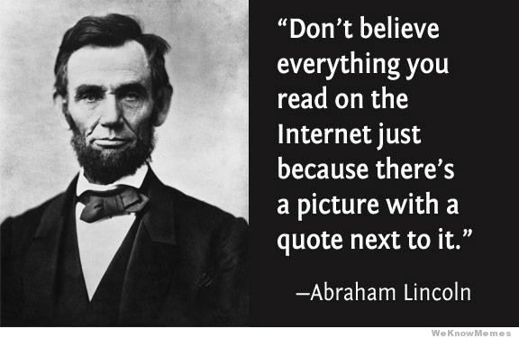

Slide 9
Integrity
The integrity of a document is ensured if it is possible to verify that the information it contains has not been altered and has been maintained in its entirety.
    An Act to Establish a Legal Framework for Information Technology, RSQ, c C-1.1 s. 6
The integrity of an electronic record may be proved by evidence of the integrity of the electronic records system by or in which the data was recorded or stored.
  Evidence Act (Ontario) s. 34.1(5.1) (cf. Uniform Electronic Evidence Act)

Slide 10






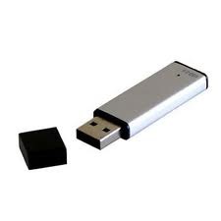
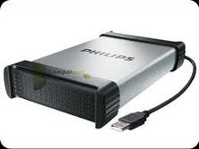
E-Doc
Information
+ metadata

Slide 11
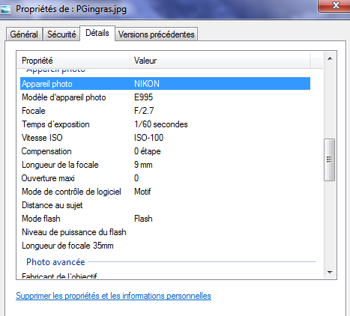
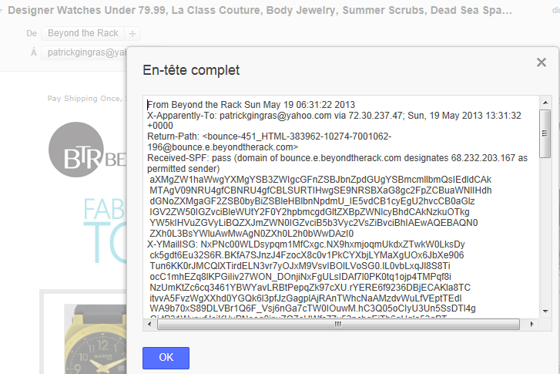
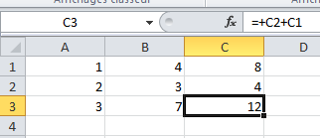
Metadata
Data about data content

Slide 12
Assure integrity on creation
Technological means
Documentation (processes);
Statutory presumptions
…

Slide 13
Demonstrate integrity at time of use
Metadata;
Documentation (processes);
Affidavit (credibility);
Expert : cf. Quebec forensic report on Minister’s agenda: http://www.cepnj.gouv.qc.ca/documents-deposes-devant-la-commission/page-document/1.html (doc 88)
Witness;
Internal logic
…

Slide 14
Expert’s report on integrity of data
Test of Expert report on Minister’s electronic files – Quebec Sept 30, 2010
http://www.cepnj.gouv.qc.ca/documents-deposes-devant-la-commission/page-document/1.html (Document 88)
[translation]
Letter from FDR Forensic Data Recovery
On 29 September 2010, we received from you a mandate to proceed to the retrieval of information stored on the items cited in the section, and to proceed to the analysis of the history of access and changes that could have been made to these files.
The first element is a CD-ROM which was referred to our analysis under the name "Association of Venice CD” (sic). We were to:
1 . Locate a file named ‘ p032026.doc’. No reference to this file could be identified in any of the media analysis.
2 . Recover the ‘p030902’ file. This file is corrupted, only a portion of information was recovered. The last modification of the file before it was fixed on the CD was on 6 January 2004. No changes could be made ​​to it since then .
The second element is a 3.5 -inch floppy disk to which we refer by the label 'Disk – Agenda of the Minister’ Our mandate was in this case to:
3. Check the history of access and changes.
The disk was created on November 12, 2004 at 2:48 p.m., and no file was modified after that date as evidenced by the time-stamping function files (‘last written’). This conclusion is also confirmed by the Analysis contained in each file’s metadata contained in the Agenda .
The Agenda files for September 2003 and January 2004 have been identified for us as of particular interest. These files were accessed on disk on September 26, 20I0, but have not been modified . We can confirm that these files were modified the last time respectively on Oct. 2, 2003.at 6:08 p.m., and on February 5, 2004 at 5:06 p.m. local time. In both cases, the last backup was performed on a workstation whose MS Office software is registered under the heading "Office of the Minister."
The third and final element is a CD-ROM to which we apply the label 'CD 2003-2004 Calendar’ in our analysis document. This CD-ROM contains an accurate copy of the information stored on the second element (Disk - Agenda of the Minister). The conclusions of our analysis are identical to that of the second element, namely that none of these files was modified after November 12, 2004.

Slide 15

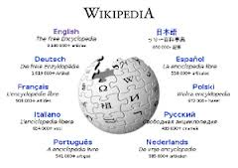
2nd scenario
During a hearing, a party wants to produce a page from Wikipedia and pictures from Google Street View and the WayBack Machine.

Slide 16
Questions
Will you accept this(ese) page(s)/picture(s)?
2. What will you have to verify? How?

Slide 17
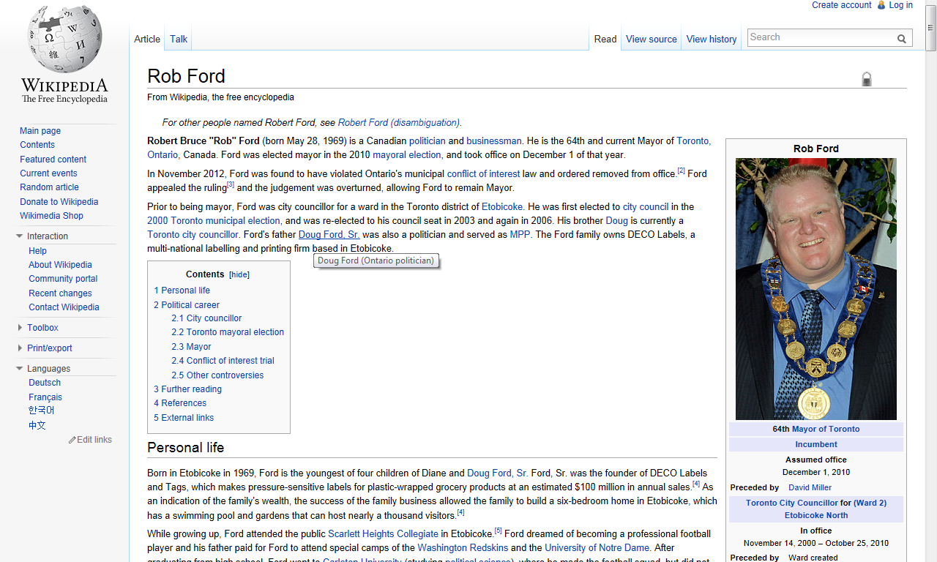
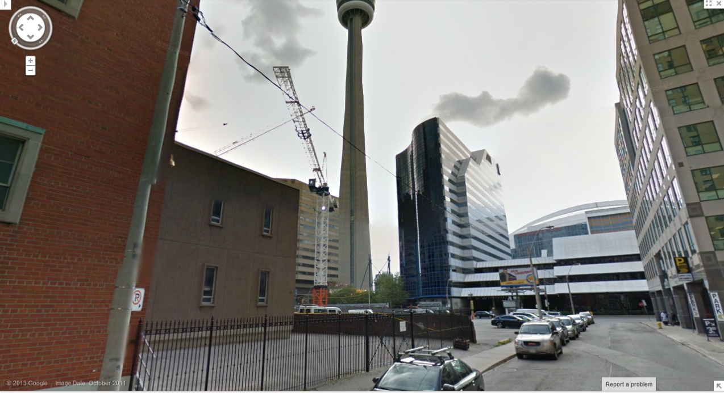
1. Will you accept this(ese) page(s)/picture(s)?

Slide 18
2. What will you have to verify?
How ?

Slide 19
Discussion
What is Wikipedia / Google Street View / WayBack Machine?
More and more used in court in Canada… why?
Wikipedia: 2 ways to see it: encyclopedia, dictionary VS community pages
  Veracity of the information (source, history)
Google Street View/WayBack Machine :
  Author and date
  How the capture has been made
  Do you need a cross-examination?

Slide 20
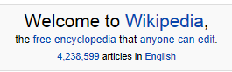
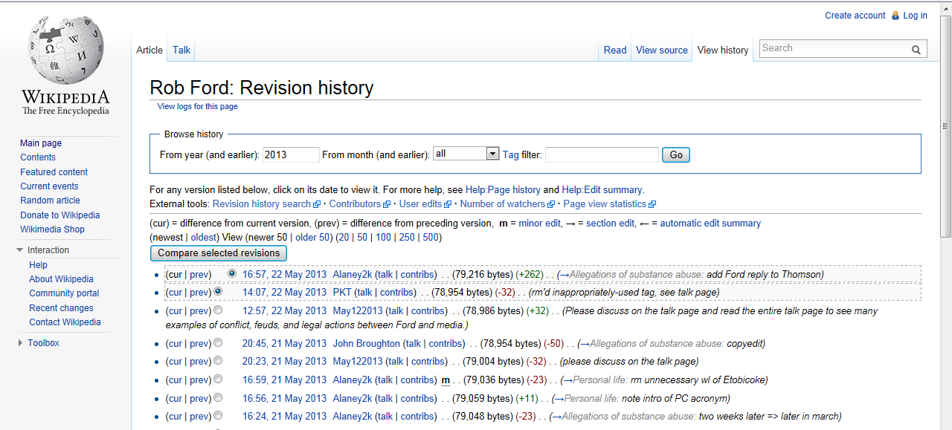
Wikipedia
What is it?

Slide 21
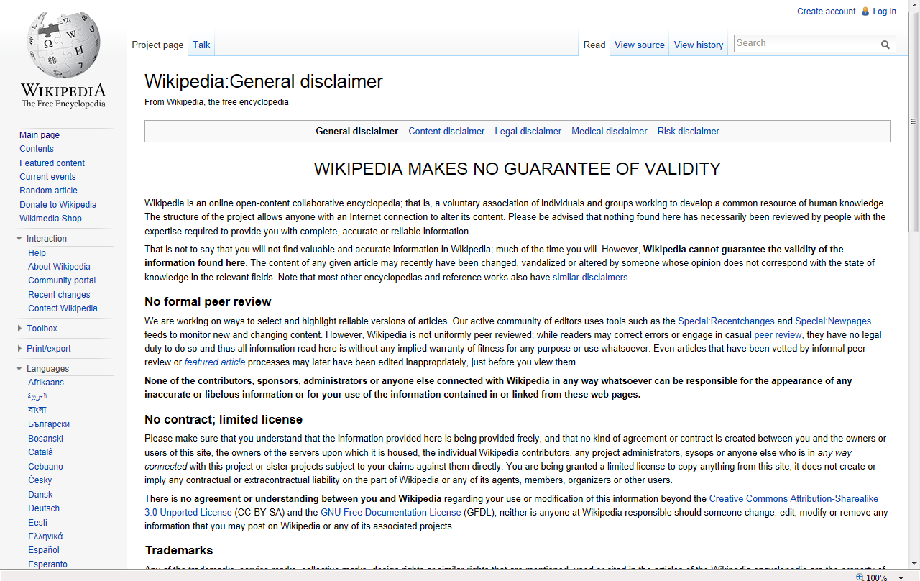

Slide 22




[60] This Court has more than once questioned the reliability of Wikipedia,. It is an open source reference with no editorial control over the accuracy of the information that can be inputted by anyone: (…)
≠
Jahazi c. Canada (Citoyenneté et Immigration), 2010 CF 242

Slide 23
Google Street View / WayBack Machine / Google Cache
Author and date
How the capture has been made
Do you need a cross-examination

Slide 24
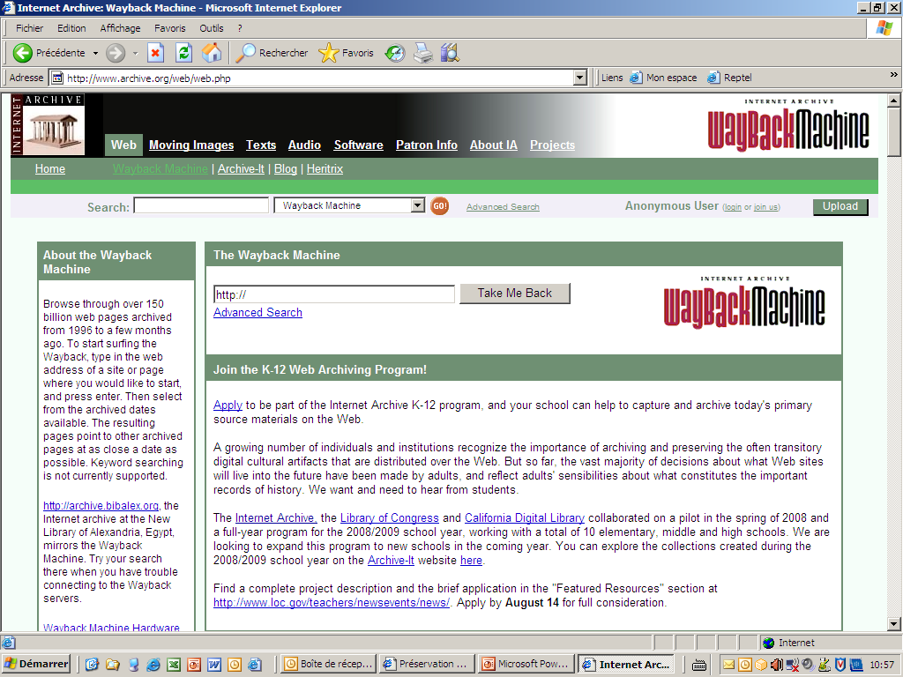

Slide 25
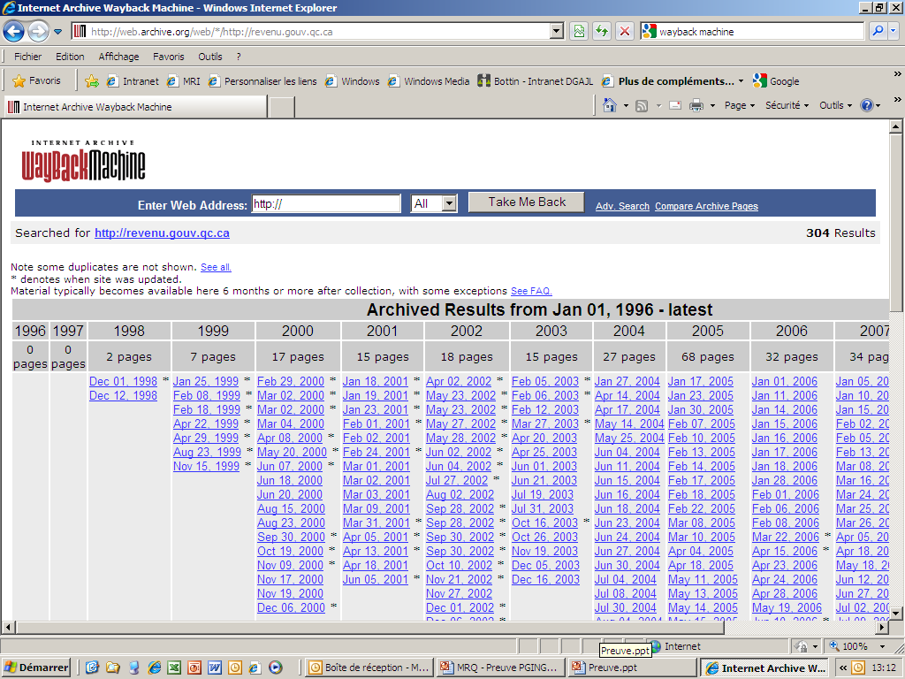

Slide 26
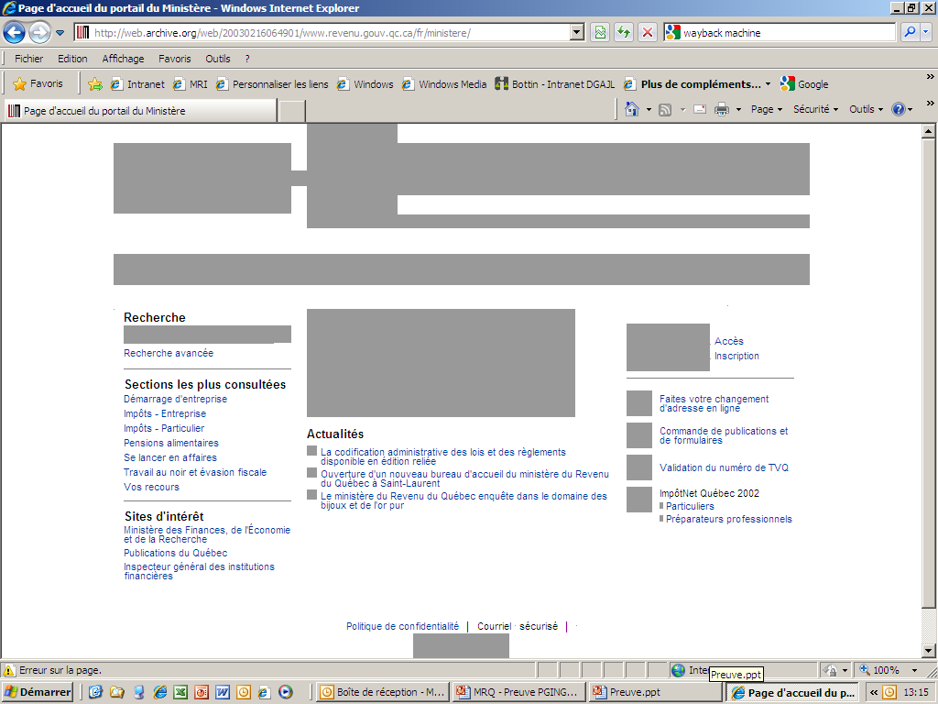

Slide 27
ITV Technologies Inc. v. WIC Television Ltd., 2003 FC 1056
[16] With regard to the reliability of the Internet, I accept that in general, official web sites, which are developed and maintained by the organization itself, will provide more reliable information than unofficial web sites, which contain information about the organization but which are maintained by private persons or businesses.

Slide 28
ITV Technologies Inc. v. WIC Television Ltd., 2003 FC 1056
[18] As for unofficial web sites, I accept Mr. Carroll's opinion that the reliability of the information obtained from an unofficial web site will depend on various factors which include careful assessment of its sources, independent corroboration, consideration as to whether it might have been modified from what was originally available and assessment of the objectivity of the person placing the information on-line. When these factors cannot be ascertained, little or no weight should be given to the information obtained from an unofficial web site.

Slide 29
More and more used in court
Easy
Free
But : …. Hearsay?

Slide 30

3th scenario
During a hearing, a party wants to produce an extract from a Facebook page (or a Twitter stream).

Slide 31
Questions
Will you accept the extract:
  As primary evidence;
  To challenge a testimony
What will you have to verify? How?
Can we create a false Facebook profile to obtain evidence or to “watch” someone?

Slide 32
1. Will you accept the extract:
As primary evidence?
To challenge a testimony

Slide 33
2. What will you have to verify?
How ?

Slide 34
3. Can we create a false Facebook profile to obtain evidence or to “watch” someone?

Slide 35
Discussion
What is Facebook / Twitter?
The extract is from a private or public page
  If information is obtained from a private page, could its use tend to bring the administration of justice into disrepute
Information from Facebook - could it be a "reasonable cause" to support a more in-depth investigation?

Slide 36
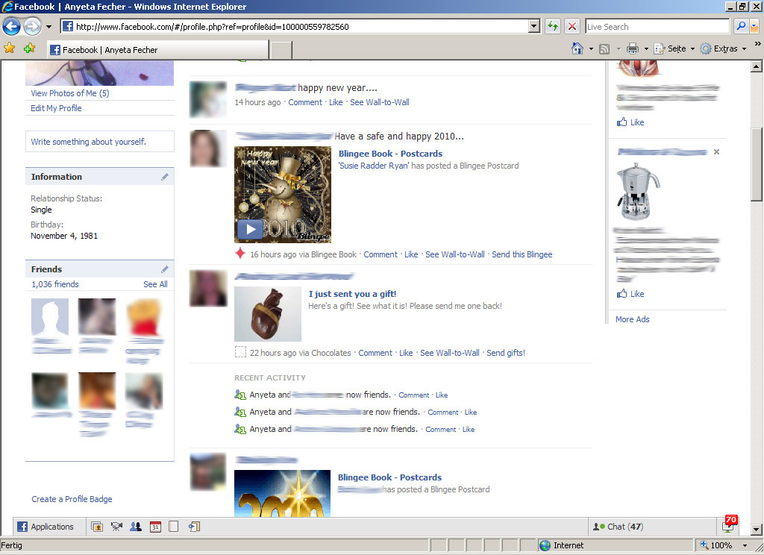
Facebook: What is it?
définition

Slide 37
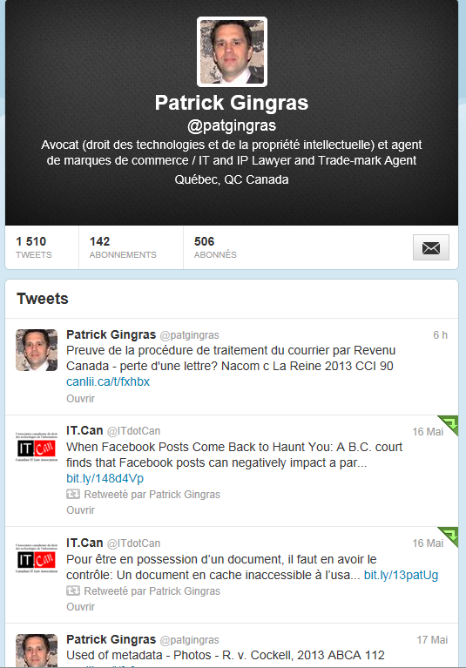
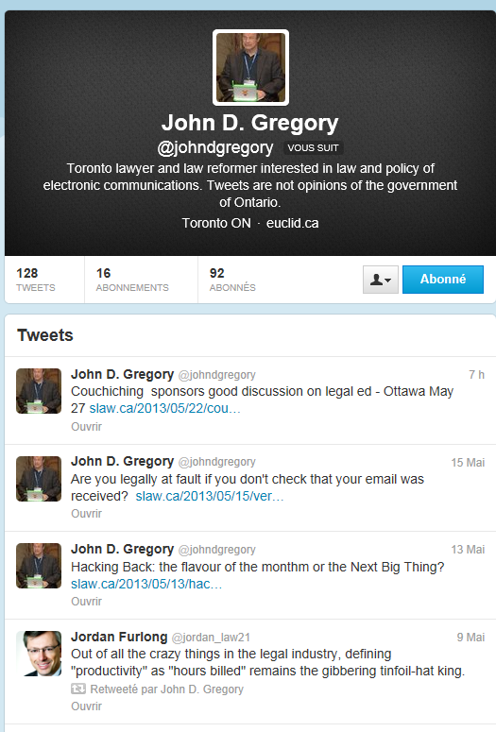
Twitter: What is it?
définition

Slide 38
Private vs public
The Plaintiff has set her Facebook privacy settings to private and has restricted its content to 67 friends. She has not created her profile for the purpose of sharing it with general public. Unless the Defendant establishes a legal entitlement to such information, the Plaintiff’s privacy interest in the information in her profile should be respected.
  Schuster c. Royal & Sun Alliance Insurance Company of Canada, 2009 CanLII 58971 (ON SC)
  The plaintiff argues that privacy concerns should be sufficient to prevent production. I disagree. The plaintiff has put her social life in issue as well as her abilility to do certain activities being negatively affected by her injuries from the accident. These issues because of this lawsuit are therefore now part of the public domain. She also posted photographs of herself, before and after the accident, on her Facebook account to others-how many is not known and is not really relevant since it was clearly more than one. Under these circumstances the privacy argument has little weight.
  McDonnel and Levie, 2011 ONSC 7151

Slide 39
False profile
Fundamental rights and freedoms breach;
Used would tend to bring the administration of justice into disrepute.

Slide 40
False profile
[50] En l’espèce, la preuve démontre que l’employeur a usé de subterfuge et de moyens détournés afin de devenir « l’ami »de la travailleuse sur le réseau social. En conséquence, la preuve Facebook présentée par l’employeur a été obtenue grâce à des moyens frauduleux. Ce constat est d’autant plus vrai que l’employeur a utilisé des informations personnelles et confidentielles de la travailleuse dans le seul but de créer un profil qui correspond parfaitement aux attentes de cette dernière
Campeau et Services alimentaires Delta Dailyfood Canada inc., 2012 QCCLP 7666

Slide 41

4th scenario
Electronic media in the tribunal hearing room / Electronic media and adjudicators.

Slide 42
Questions
Can we tweet or otherwise communicate electronically during an hearing?
  Are there different rules for different classes of people in the room?
Can a judge have a Facebook page or LinkedIn profile (impartiality – neutrality)?
Can adjudicators be ‘friends’ with counsel or representatives of parties?
Should decisions be released on social media platforms?

Slide 43
Discussion
Principles for e-media in the hearing room:
  Disruption
  Improper activities (communicating with excluded witnesses, breaking publication bans)
  Reasons to distinguish classes: media, counsel, parties, public

Slide 44
Tweeting during a hearing ?
  Are there different rules for different classes of people in the room?
  Quebec rules - http://www.tribunaux.qc.ca/c-appel/English/Current/new/docs/dir_utilisation_techno_salle_audio-a.pdf
  Ontario rules - http://www.ontariocourts.ca/scj/en/policies/electronic-devices.htm

Slide 45

Judge / Juge & Facebook / LinkedIn

Slide 46
Canadian Union of Postal Workers v. Canada Post Corporation, 2012 FC 975
[12] A pre-hearing conference was held on April 30, 2012, at which the appellant's counsel again requested that the arbitrator recuse himself in light of new information. The first piece of information was a Facebook page in the arbitrator's name, in which the "activities and interests" category included links to the Westmount Ville-Marie Conservative Association and the page for Michelle Rempel, Conservative Member of Parliament for Calgary Centre-North. The page also contained a list of "friends", including Minister Raitt, who was responsible for appointing the arbitrator, as well as Minister Steven Fletcher, the minister responsible for Canada Post. In May 2012, Arbitrator Dufort removed these links from his Facebook page.

Slide 47
Adjudicators’ “friends”
A judge may participate in electronic social networking, but as with all social relationships and contacts, a judge must … avoid any conduct that would undermine the judge’s independence, integrity, or impartiality, or create an appearance of impropriety.
Judge's Use of Electronic Social Networking Media (American Bar Association Standing Committee on Ethics and Professional Responsibility, Formal Opinion 462 ) February/février 2013
  http://goo.gl/UgV3B

Slide 48
Decisions released on social media platforms
From the Supreme Court
https://twitter.com/SCC_CSC
https://twitter.com/USSupremeCourt
But: https://twitter.com/iSupremeCourt
From the cloud: http://www.lexum.com/en/products/decisia
Government :
https://twitter.com/ontmag

