Slide 1
The Canadian Bar Association
L‘Association du Barreau canadien

Slide 2
Reaching Equal Justice
Notes:
When it was created by CBA Council in 2011, the CBA’s Access to Justice Committee was given the mandate of coordinating CBA policy on access to justice – legal aid, pro bono and initiatives to improve access for the middle class.
The Committee launched its comprehensive Equal Justice initiative a year later, at the CLC in August 2012. Some major events since then include,
Envisioning Equal Justice Summit in Vancouver this April, attended by over 250 people from every province and territory
Our Summary report released in August, at the 2013 CLC.
The National Action Committee report released in October 2013. The CBA has been an active member of the Action Committee since its inception. We were pleased to see that it was very much in line with the CBA’s report.
Our full report will be posted on line December 17; it is intended to be interactive, with opportunities for ongoing feedback throughout.

Slide 3
Barriers to Progress
lack of public engagement
absence of comprehensive strategy or coordination
no mechanisms to measure change
information gaps, lack of research
Notes:
We began our work by identifying barriers to progress on access to justice:
lack of public engagement or profile of the issue; people don’t see the justice system as their own, designed to serve their needs, and so, there is no political pressure for government leaders to make justice a priority
an absence of a comprehensive strategy or coordination; we have a lot of organizations and individuals working on access to justice, but no national coordination or collaboration – it’s been called a system of systems, or a body without a brain
no mechanisms to measure change - we are short on metrics to measure progress. We don’t keep reliable comparable data on justice
information gaps – we have made progress in Canada on civil legal needs research, but there are many areas where research about what works and for which populations is lacking

Slide 4
Strategies for Change
Research and consultations
Marginalized communities in Toronto, Montreal, Saskatoon, Calgary, and in the Maritimes
“On the street” interviews
Survey of legal aid lawyers, community legal workers, paralegals
Pro bono organizations and CBA Council
Five ‘building block’ papers circulated broadly
Notes:
We then developed three main strategies to tackle these Barriers:
1. Research and consultation – this strategy involves 5 ‘building blocks’ to ground the initiative
To base our work in the perceptions of the public, and especially those members of the public most in need, we began by holding focus groups with marginalized communities;
We also collaborated with student volunteers from PBSC, who conducted “on the street” interviews in various parts of the country
We surveyed legal aid providers; and got over 700 responses, and
We consulted with pro bono organizations and CBA Council
From October 2012 – April 2013, we circulated five Discussion papers
Access to Justice Metrics
National Standards for Publicly Funded Legal Services
Future Directions for Legal Aid Delivery
“Tension at the Border”: Pro Bono and Legal Aid
Underexplored Alternatives for the Middle Class

Slide 5
Strategies for Change
National collaboration
Work with National Action Committee on Access to Justice in Civil and Family Matters
A new conversation
Began with Envisioning Equal Justice Summit, April 2013
Notes:
The second strategy is to improve national strategic collaboration and coordination
To date we have involved system participants in all the building block projects
And, we have worked with National Action Committee throughout
But, this will require our ongoing efforts into the future.
Finally, we took steps to initiate a new conversation, focused more on achieving results for people who need legal help, and less on the interests of the justice community. As I mentioned, this includes
Consultations within and outside the profession
Envisioning Equal Justice Summit, April 2013
There we asked people to leave the “day jobs” at the door, and take a fresh look at ways to work together to achieve change

Slide 6
Everyone is Entitled to Justice
Who needs what kind of help?
Notes:
From this work to date, our Committee agreed that 100% access to justice is the only defensible goal.
Inaccessible justice costs us all, but harshest consequences on the poorest people. At the heart of our work is a call for the justice community to recommit to equal justice, and continually ask: who needs what kind of help in accessing justice. Offering written materials to someone who is illiterate will not mean progress.
We need to talk about and make visible the pain caused by inadequate access and the huge discrepancies between the promise of justice and the lived reality of the barriers and impediments many people experience. When we ignore or avoid that reality, we actually exacerbate rather than mitigate inequality.

Slide 7
What We Heard
Legal Rights are ‘Just on Paper’
“It always feels like, oh, that’s the law and there’s nothing you can do about it.” Aboriginal woman, Saskatoon
Justice Systems Cannot Be Trusted
“I feel intimidated and bullied by the legal system.” Domestic violence survivor, Calgary
Notes:
The shortcomings of the justice system now came across loud and clear in the consultations we held with marginalized communities, where 4 main themes emerged as to how members of those communities perceive the justice system. According to them:
Legal Rights are Just on Paper
Justice Systems Cannot Be Trusted

Slide 8
Justice is Person‐Dependent
“With lawyers you get the good with the bad, some who care, some who don’t.” Deaf man, Toronto
Justice Systems are Difficult to Navigate
“It is overwhelming ... you feel incapacitated.” Single mother, Moncton
Notes:
Justice is Person‐Dependent
Justice Systems are Difficult to Navigate
Our reports include many more quotes from our community focus groups, and a summary of the comments received is available on the CBA website.

Slide 9
What We Know
Law thick world
Unresolved legal problems multiply
Unresolved legal problems spread
Vulnerable groups hit hardest – 22% have 84% problems
Vulnerable groups don’t seek help, distrust the system
Yet, legal help leads to better outcomes
Notes:
There is a lot that we don’t know about a2j and as I mentioned, a shortfall in information, research and statistics is a major barrier to progress. But the research that HAS been done, in Canada and internationally, has established that:
Legal problems arise more frequently than people expect
Unresolved legal problems grow, become more legal problems
Unresolved legal problems spread to other areas of life
Vulnerable groups hit hardest – 22 % of people have 84% of legal problems
Also, vulnerable groups more likely not to seek help, to distrust the system, see justice as for the rich
But, we also know that legal help leads to better outcomes

Slide 10
A Case for Change
Lack of data, research on access to justice
Everyone has legal problems
Direct relationship between the courts and democracy
Growth in poverty and social exclusion
Costs of inaccessible justice
Return on investment for legal aid spending
Why tinkering is insufficient
Notes:
Some arguments for change are outlined on this slide.
I’d note especially that current international research is suggesting strong practical reasons for ensuring meaningful access to justice. In addition to preventing suffering and advancing equality, it saves public money in the long run and results in better outcomes. Studies from Australia, UK and US are building a business case by quantifying the return on investment for legal aid dollars.
The average demonstrated social return on investment is that every $1 of legal aid spending results in about $6 in benefit to the public purse in other areas (but this figure ranges from about $2- $30)

Slide 11
Ambitious, but Possible
An inclusive justice system requires that it be equally accessible to all, regardless of means, capacity or social situation.
Notes:
So, we are calling for major change, tinkering will not be enough. Many people and organizations are trying, but how can we say if ad hoc interventions are helping, without an overall strategy and national plan. In fact, individual initiatives may operate at cross-purposes, or risk hindering the cause by fostering complacency and diminishing support.
The Reports are framed as invitations to engage, to envision and to act. They are not designed to provide ‘the answer’, but we hope they will inspire people to join us in a new, different kind of conversation about access to justice, and then act together to make important changes.
They offer the Committee’s vision of equal justice, and a strategic framework for action. They bring together current key ideas with the goal of making them more concrete, hoping that will enable and encourage action.
We are asking ALL members of the justice community to consider how they are personally able to contribute to a different kind of justice system , one owned by and aimed on serving the public’s needs.

Slide 12
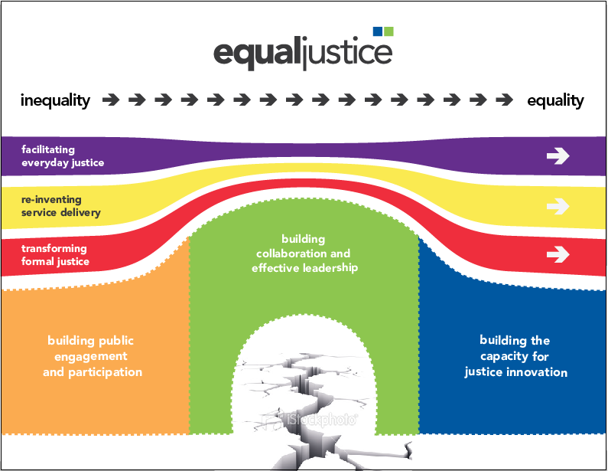
Bridge to Equal Justice
Notes:
The reports start with an overview of the problem. The crux is that justice is devalued in Canada. Our governments dedicate only about 1% of their spending to it (compared to 40% for health care).
Having described the problem, the Reports propose a vision of an accessible justice system. We express this in a series of 31 measurable goals or “targets”. The targets all relate either to strategies to fix the problems we have identified, or to structural supports we have learned will be necessary for change.
We use a bridge to illustrate how the strategies and the necessary supports for change fit together.

Slide 13
Bridge to Equal Justice
3 Lanes of the Bridge
Facilitating everyday justice
Reinventing service delivery
Transforming formal justice
Notes:
The 3 LANES on the bridge represent in broad strokes the main strategies for change:
Facilitating Everyday Justice
Most people don’t go to the formal justice system with their problems, so we talk about everyday justice, and emphasize that prevention is always far better than the cure.
regular legal health checkups - People check in periodically to avoid blow ups later
legal capability training starting in high school, so that a basic understanding of law is considered a life skill.
integrated triage and referral system for both government and private services, advertised to the public and available at the entry point to the system, so people are directed to the right services at an early stage
offering technology in a way that doesn’t leave behind a large swath of people who lack literacy skills or access to a computer, and accompanied by human help.
Reinventing Service Delivery
Another lane considers how lawyers and other service providers can change the way we offer services to improve a2j, and this is the area where the Futures Initiative you heard about yesterday overlaps with the Equal Justice initiative.
Targets in this section relate to:
Limited Scope Retainers People Centered Law Practices
Team delivery of legal services Legal Expense Insurance
Regenerating publicly funded legal services Bridging the public/private divide
and,
Changes to Law schools and Legal education – integrating access to justice more successfully into law school curricula
Transforming Formal Justice:
We suggest that courts should continue to have a central function, but with an expanded role to become the main pathway to access dispute resolution processes, integrating effective triage and referral processes.

Slide 14
Bridge to Equal Justice
3 Supports for the Bridge
Building public engagement and participation
Building collaboration and effective leadership
Building capacity for justice innovation
Notes:
Turning now to the 3 SUPPORTS to our bridge – the necessary foundations for change, first we have:
Building Public Engagement and Participation
We need a convincing answer when people ask, why should I care about equal justice. The target here proposes ways for the Canadian public to own the justice system, and for governments to use the public perspective to guide reforms.
Building Collaboration and Effective Leadership
Here we call for ongoing collaborative structures to bring together stakeholders and establish networks between equal justice communities. Effective leadership is required, and we also call for champions for change to create better roads to communication and collaboration between communities and formal, well funded, access to justice commissioners at f/p/t levels
Building Capacity for Justice Innovation
This section is about achieving systemic change. The Hague Institute for the Internationalisation of Law says that an eco system to nurture the process is necessary, one that, for example, treats failure as a good thing, the beginning of adaption, improvement and eventual success.
In Canada, capacity for justice innovation is lacking, and we suggest creating a Canadian Centre for Justice innovation, metrics to collect and track data, and ground future action and policy making, and a strategic framework for access to justice research. We also call on the federal government and the CBA to become more engaged as access to justice leaders.

Slide 15
Targets
Imagining 2030 – 31 Targets
Actions to start now
Milestones along the way
Ultimate Goal
Notes:
The 31 Targets propose that we reach equal justice by 2030.
One strong factor influencing this decision is that time will be required to build capacity to evaluate whether reforms work. Part of the change process is increasing our shared capacity for learning and adaptation.
While 2030 is a long way off, each target includes milestones (interim goals), as well as actions to begin right now. The milestones and actions are indicative rather than comprehensive, a starting point rather than a detailed guide. They propose a way forward, recognizing that more detail is required and should be developed over time, by those working most closely on the particular target.

Slide 16
“Think systemically, act locally”
How can the things I do locally contribute to systemic change?
Notes:
Our reports note an increasing consensus about the need for significant change to improve access to justice, and on the central directions for reform. There is a lot of work to do and that work needs to be shared over a broader segment of the legal profession and other justice system personnel than are currently engaged in the access project.
The challenge is to think of our roles in the justice system more expansively, each working to produce the best possible results for our individual clients, the individual case, in our association or institution, while simultaneously working to produce the best possible justice system. In a riff on the idea of thinking globally, acting locally, the Committee asks you to think systemically, act locally.
The targets in the report are the big picture end goals, but there are lots of small actions to help get there. Consider the targets proposed and the change-oriented ideas and ask yourself: what I can do, either myself or working with others, to contribute to equal access to justice?

Slide 17
Our Goals
national framework for more coordinated action
new direction for the equal justice conversation
inspire action, get started on change
Notes:
At the Committee’s National Summit in Vancouver in April, we heard from international experts in system-wide change, who say that change is possible if you start with a common understanding of the problem and a shared vision of the solution.
Then, you need measurable goals to guide you to that vision. We hope that the framework in our Reports can facilitate that change process in Canada, allowing people in the justice community to work on their piece of the problem in a way that they know contributes to overall improvement.
Our full Report will be released on Tuesday, and provides details of the 31 proposed targets – each one offers an opportunity for comment and to get involved. We hope to hear from you!

Slide 18
Key Targets
Law as a life skill
Effective triage and referral
Inclusive technology solutions
Transformation of formal justice
Access to justice metrics
Rejuvenation of public funding
Collaboration among stakeholders

Slide 19
Collaboration
Some current priorities for CBA A2J Committee:
Training on Triage/Referral
Technology survey
Work with Courts on specialized procedures, data collection, eliciting public feedback
National Benchmarks
How can we work together on these issues?

Slide 20
Equal Justice
The time for talk has passed.
Now is the time for action.
Thank you!

