Slide 1
I&IT Accessibility within OPS
SOAR Annual Conference
November 6, 2014
Michael Y Chan
Sekaly Osman

Slide 2
What is ACOE (Accessibility Centre of Excellence)?
March 2007, ITELC approved the Project Charter for the I&IT Accessibility Centre of Excellence (ACOE)
Advice and guidance on implementing accessible I&IT solutions
  Websites
  Web-based applications
  Documents, Forms
  Enterprise Architecture, Project Management, I&IT Project Governance
Support IT project teams across all Clusters and Ministries in meeting regulatory requirements under Accessibility for Ontarians with Disabilities Act (AODA) Integrated Accessibility Standards Regulation (IASR)
Provides a centralized OPS resource for staff seeking advice and guidance related to I&IT accessibility

Slide 3
What do we do? Services & Initiatives
Web and Document Accessibility Assessment Service
Automated Testing Tool – HiSoftware Compliance Sheriff – license and support
Integrating Accessibility into I&IT Projects Initiative
  - Incorporate accessibility into Project Management and Enterprise Architecture

Slide 4
Web and Document
Accessibility Assessment Service

Slide 5
ACOE Assessment Service
ACOE Accessibility Assessment Service available to OPS staff
High level assessments of websites, web applications, documents etc.
  Structured and repeatable evaluation methodology modelled after W3C best practices
  Accessibility Assessment Outcome (AAO) Reports and remediation tips provided to client
To identify key accessibility issues based on WCAG 2.0 Level AA
No direct cost to OPS staff
ACOE do not validate on behalf of the government and do not certify for compliance to AODA.
  For comprehensive assessments, 3rd party vendors should be acquired
Notes:
5

Slide 6
ACOE Assessment - Service Request
Service Request Process
  Fill out our service request form ontario.ca/itaccessibility
    Provide URL link or document attachments
    Provide test scripts / functionalities to test
  Acknowledgement reply within 1 business day
  Assessment turn-around time depends on size and scope
    Up to 10 business days
Notes:
6

Slide 7
Automated Testing Tool
HiSoftware Compliance Sheriff

Slide 8
Background
June 2010 – ACOE procured HiSoftware Compliance Sheriff subscription licence through a competitive procurement process
HiSoftware Compliance Sheriff
  Web-based tool accessed via the browser by the end users
  No client installation is required
  Free to use for OPS staff to assess OPS internet and intranet websites
  Unlimited user seats
Established an OPSPedia User Group to support Compliance Sheriff users
Notes:
8

Slide 9
HiSoftware Compliance Sheriff Features
Supports WCAG 2.0 Level A, AA
Provides automated testing for programmatic checkpoints
Wizard to verify manual checkpoints
Customize reports
Ability to scan entire website (crawl site by levels)
Facilitates code-repair suggestions and changes
Notes:
9

Slide 10
Tool Registration
To register and access the tool, please complete the HiSoftware Compliance Sheriff Access Request Form available on the ACOE intranet site:
  http://ontario.ca/itaccessibility
After you complete the form and receive a user name, password and user guide (within 1 business day), the tool can be accessed at:
http://10.77.8.43/compliancesheriff
Notes:
10

Slide 11
Integrating Accessibility into I&IT Projects Initiative

Slide 12
Integrating Accessibility into I&IT Projects Initiative
Incorporating accessibility into OPS I&IT methodologies and frameworks
  Project Management, Enterprise Architecture, Systems Development Life Cycle (SDLC)
Developed I&IT Accessibility Guidebook (2011)
  Provides guidance to IT professionals on how to consider accessibility at each step of the project life cycle and governance
Created supporting documents
  Accessibility Requirement Pattern (ARP) for WCAG 2.0
  IASR enterprise architecture questionnaire

Slide 13
Integrating Accessibility into I&IT Projects Initiative
Conducted 18 workshops to promote the I&IT Accessibility Guidebook to Architecture and PM teams across 9 clusters
Review IT projects for accessibility at Corporate Architecture Core Team (ACT) governance
Cluster Accessibility Governance Model Pilot with LTC
  Knowledge transfer to a LTC lead architect
  Establish IT accessibility lead at cluster ACT governance to help IT projects meet compliance requirements within architecture

Slide 14
ACOE – IT Project Evaluation Service
Consultation Service
  Support project early engagement sessions to inform IT project teams of their accessibility obligations related to PM and EA.
IT Project Evaluation Service
  Help project teams address accessibility within their project documents.
  ACOE reviews:
  • Business Case
  • Project Charter
  • Project Plan
  • Checkpoint materials and presentations
  • Business Architecture Report
  • Logical and Physical artifacts
  • Any other materials that may be relevant
  To request service, fill out ACOE intranet service request form

Slide 15
ACOE Collaboration
Active participation and meetings for the following working groups:
Web Coordinators Committee
Diversity Office Accessibility Forum
ITS TTY / Accessibility Support advisory group
Mobile Application Development committee
Diversity Office Alternate Formats Working Group
Diversity Office Documents Training Working Group
Diversity and Inclusion I&IT roadmap Working Group
Service Ontario VISION project Working Group
Digital Strategies Working Group

Slide 16
Integrated Accessibility Standards Regulation (IASR) - excerpt
Section 14 Accessible websites and web content
The Government of Ontario and the Legislative Assembly, for both their internet and intranet sites, shall meet the requirements in this section in accordance with the following schedule:
By January 1, 2012: New internet and intranet websites and web content on those sites must conform to WCAG 2.0 Level AA, other than:
  Success criteria 1.2.4 Captions (Live), and
  Success criteria 1.2.5 Audio Descriptions (Pre-recorded).
By January 1, 2016: All internet websites and web content must conform to WCAG 2.0 Level AA other than:
  Success criteria 1.2.4 Captions (Live), and
  Success criteria 1.2.5 Audio Descriptions (Pre-recorded).
By January 1, 2020: All internet and intranet websites and web content must conform to WCAG 2.0 Level AA.

Slide 17
WHAT IS WCAG?
First introduced as version 1.0 in 1999, and the current WCAG 2.0 standard was released in 2008.
The Web Content Accessibility Guidelines are typically referred to by their acronym WCAG (pronounced "wick-ag"). It’s a series of guidelines created by the World Wide Web Consortium (W3C) in order to improve website accessibility.
Following these guidelines will make content accessible to a wider range of people with disabilities, including blindness and low vision, deafness and hearing loss, learning disabilities, cognitive limitations, limited movement, speech disabilities, photosensitivity and combinations of these.

Slide 18
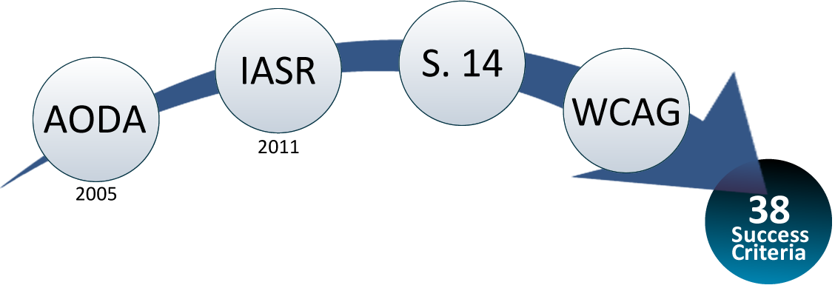
WCAG 2.0: A CLOSER LOOK
SUCCESS CRITERIA
WCAG 2.0 success criteria are written as testable statements that are not technology-specific. All Success Criteria are important access issues for people with disabilities.
Each is assigned a conformance level taking into consideration a wide range of interacting issues. There are 38 Level A and Level AA Success Criteria. AODA compliance, with regards to obligations for websites, is essentially meeting those 38 criteria.

Slide 19
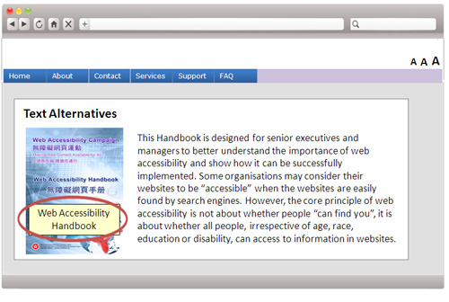
WCAG 2.0 KEY CONSIDERATIONS
Non-Text Content
All content on a website must be able to be represented in text so that it can be read by screen readers. For example, images must have a text description.

Slide 20
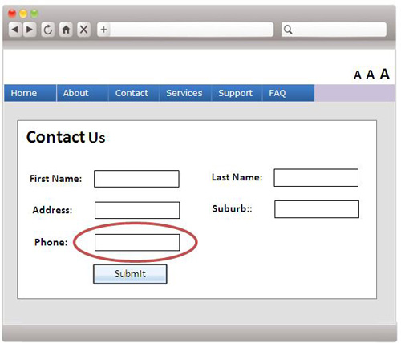
WCAG 2.0 KEY CONSIDERATIONS
Labels or Instructions
To help persons with disabilities avoid making mistakes, it is good to provide simple instructions and cues for entering information into forms.

Slide 21
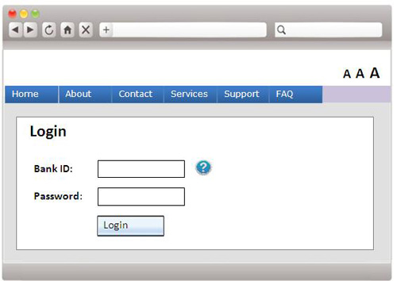
WCAG 2.0 KEY CONSIDERATIONS
Navigation by Keyboard Alone
Ensure all content and functions can be accessed through the keyboard and that content does not "trap" keyboard focus.

Slide 22
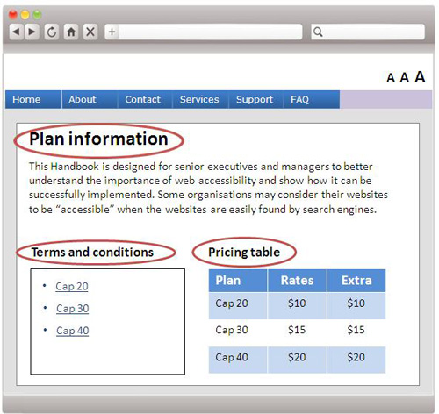
WCAG 2.0 KEY CONSIDERATIONS
Document
Structure
Users who are not disabled can view the layout of a webpage and quickly determine its heading structure and hierarchy.

Slide 23
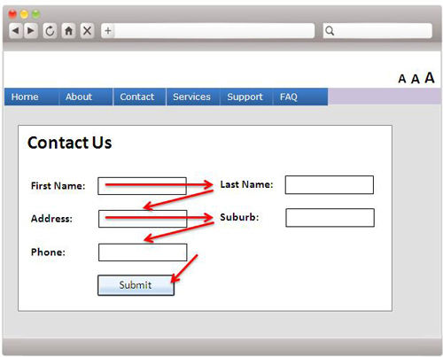
WCAG 2.0 KEY CONSIDERATIONS
Meaningful Sequence
If the content needs to be read in a certain order to make sense, ensure the webpage is written and coded in a way which indicates this order.

Slide 24
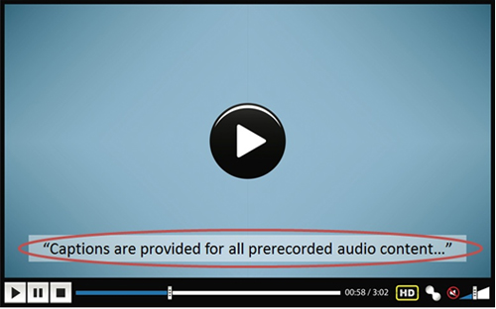
WCAG 2.0 KEY CONSIDERATIONS
Captions & Transcripts
Provide captions and transcripts for audio/v content so that they are accessible by persons with hearing impairments.

Slide 25
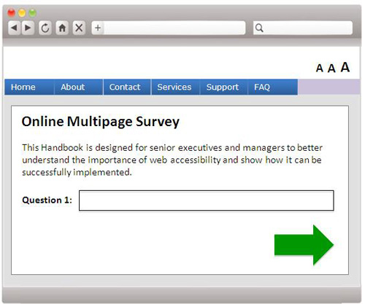
WCAG 2.0 KEY CONSIDERATIONS
Use of Color and Shapes
Do not rely solely on colors or shapes alone to convey information. It is impossible to be sure that everybody perceives colors and shapes in the same way.

Slide 26
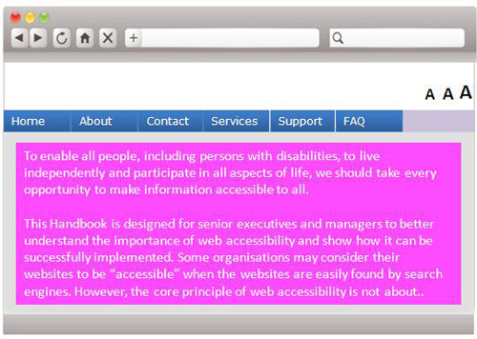
WCAG 2.0 KEY CONSIDERATIONS
Color Contrast
Design text and images so that they have a contrast ratio of at least 4.5:1 between the background and the foreground to make it easy to read.

Slide 27
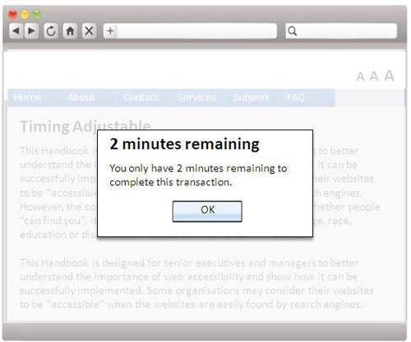
WCAG 2.0 KEY CONSIDERATIONS
Timing Adjustable
Ideally ensure processes on a website are not time dependent. If they are, ensure persons with disabilities can either adjust or stop the time limit.

Slide 28
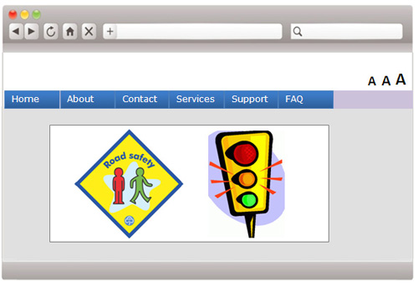
WCAG 2.0 KEY CONSIDERATIONS
No Flashing Content
Ensure all flashing items are dimmed, and cover only a small area of the screen or the flash rate is three times per second or less.

Slide 29
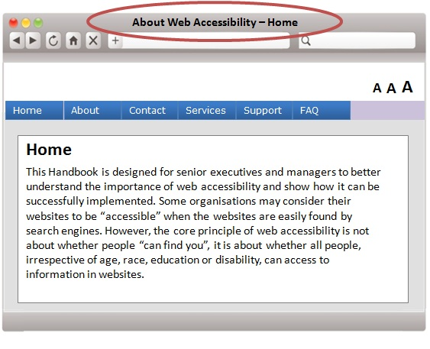
WCAG 2.0 KEY CONSIDERATIONS
Page Titled
Give webpages a title that accurately describes what the content is about. This will help persons with disabilities differentiate the webpages in their browser history.

Slide 30
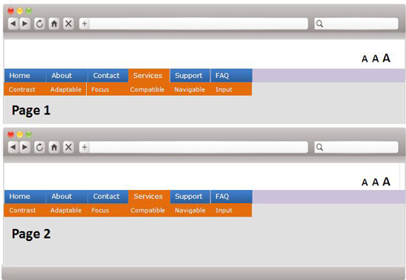
WCAG 2.0 KEY CONSIDERATIONS
Consistent Navigation
Where navigations or links are on multiple webpages, ensure they are presented consistently across all pages.

Slide 31
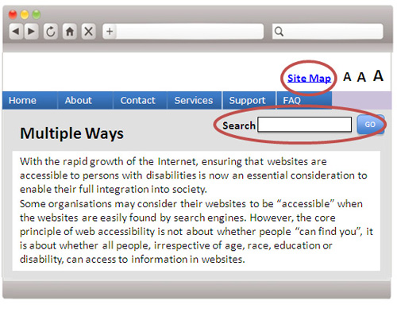
WCAG 2.0 KEY CONSIDERATIONS
Multiple Ways Navigate
Ensure there is more than one way to access a webpage, for example, by using a search function, site map, standard navigation, etc.

Slide 32

WCAG 2.0 KEY CONSIDERATIONS
Language of Page
Ensure the primary language of a webpage is defined within the HTML code. The correct speaking language will be loaded by screen readers to read the words in the webpage.

Slide 33
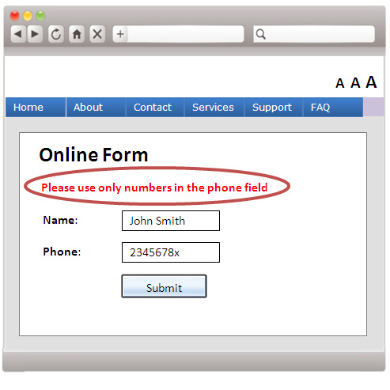
WCAG 2.0 KEY CONSIDERATIONS
Error Identification
& Suggestion
If a user makes a mistake, use text to show him/her where and what he/she has done wrong, and how he/she can fix it.

Slide 34
ACOE Resources
ACOE Intranet website
  www.ontario.ca/itaccessibility
Resources related to this presentation are below:
  I&IT Accessibility Guidebook
  I&IT Accessibility Checklist
  ACOE Accessibility Requirement Pattern
  Web Content Accessibility Guidelines 2.0

Slide 35
Contact Information
Neill Kernohan
Manager, Employee Engagement
Telephone: (416) 327-8967
Email: neill.kernohan@ontario.ca
Michael Chan
A/ Manager, I&IT Accessibility Planning
Telephone: (416) 212-2213
Email: michael.y.chan@ontario.ca
Dan McGuire
Accessibility Technology Analyst
Telephone: (416) 212-2560
Email: dan.mcguire@ontario.ca
Amit Aggarwal
Sr. Accessibility Technology Analyst
Telephone: 647-224-3995
Email: Amit.M.Aggarwal@ontario.ca
Sekaly Osman
QA Specialist
Telephone: 416-212-4163
Email: sekaly.osman@ontario.ca

