Slide 1
Transparency
SOAR Annual Conference
Access to Justice: Change the Culture, Shift the Paradigm
November 6, 2014
Maureen Boon
Senior Advisor, Executive Office

Slide 2
Overview
The CPSO
Transparency Initiative
Current approach
Future plans

Slide 3
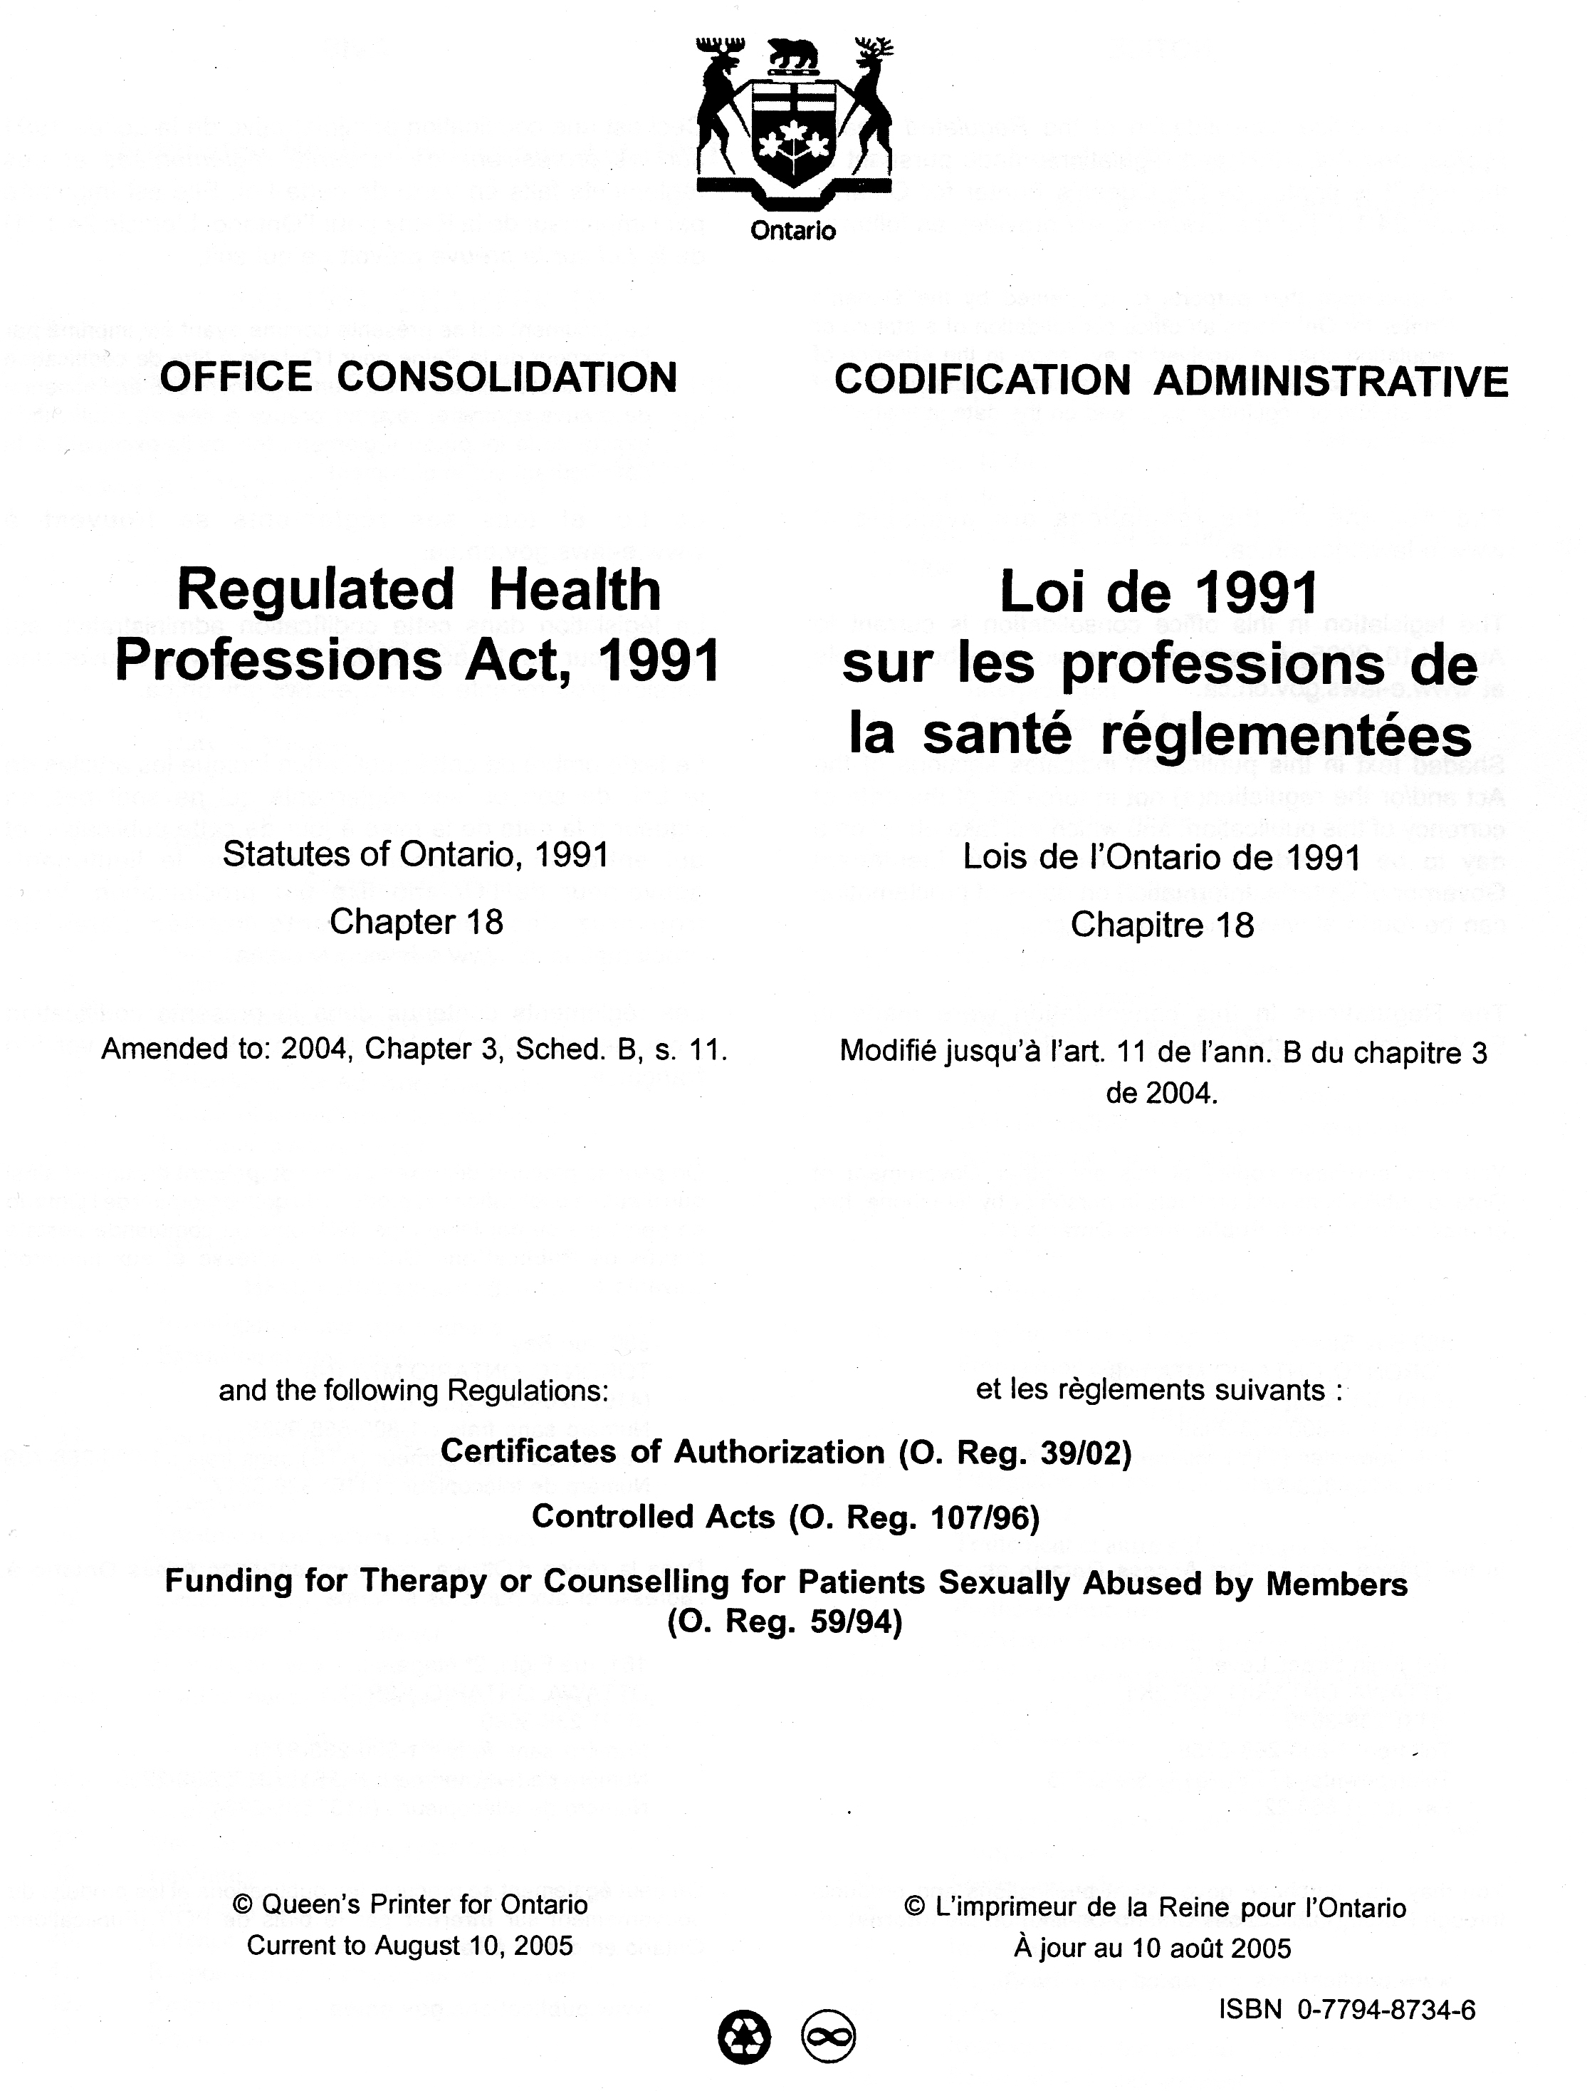
Self-regulation
A privilege granted by government to health professions, in law.
Regulated Health Professions Act, 1991
CPSO regulates the profession in the public interest.

Slide 4
Issue certificates of practice
Set and maintain standards of practice
Develop policies to guide the profession
Respond to complaints

Slide 5
Public Trust
Accountability
Transparency

Slide 6
Public Trust
Information provided to the public (about processes, outcomes, or members) should enhance public trust and/or safety.

Slide 7
Transparency
Processes
Outcomes
Members

Slide 8
Processes

Slide 9
Accessibility
Awareness of the CPSO is relatively low
However, Google….
Notes:
Info has to be more than accessible – public must have trust in the processes…..

Slide 10
Making a Complaint
Patients can call to discuss concerns
Information about process is available on the website
Complaints need to be made in writing or other permanent form (disc or tape)

Slide 11
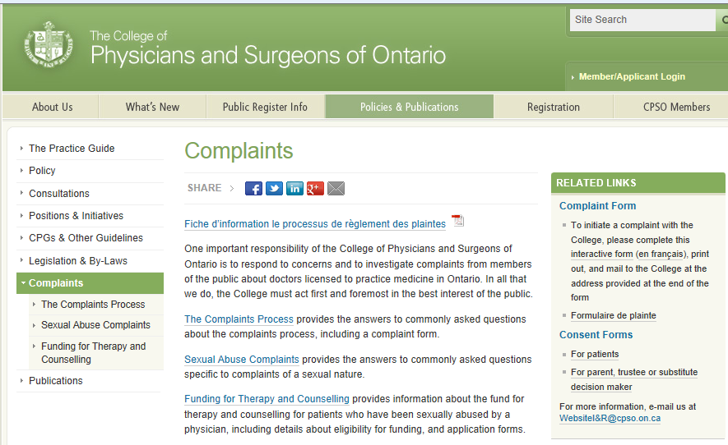

Slide 12
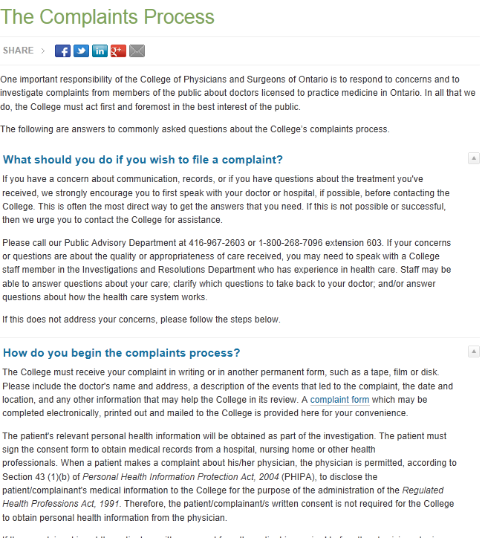

Slide 13
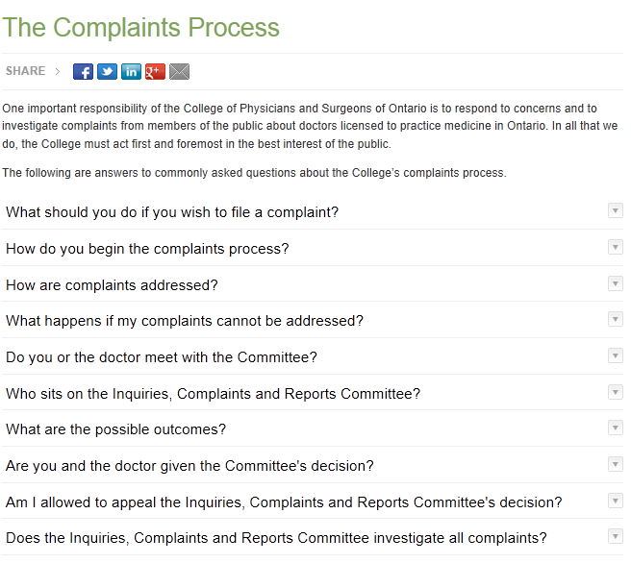

Slide 14
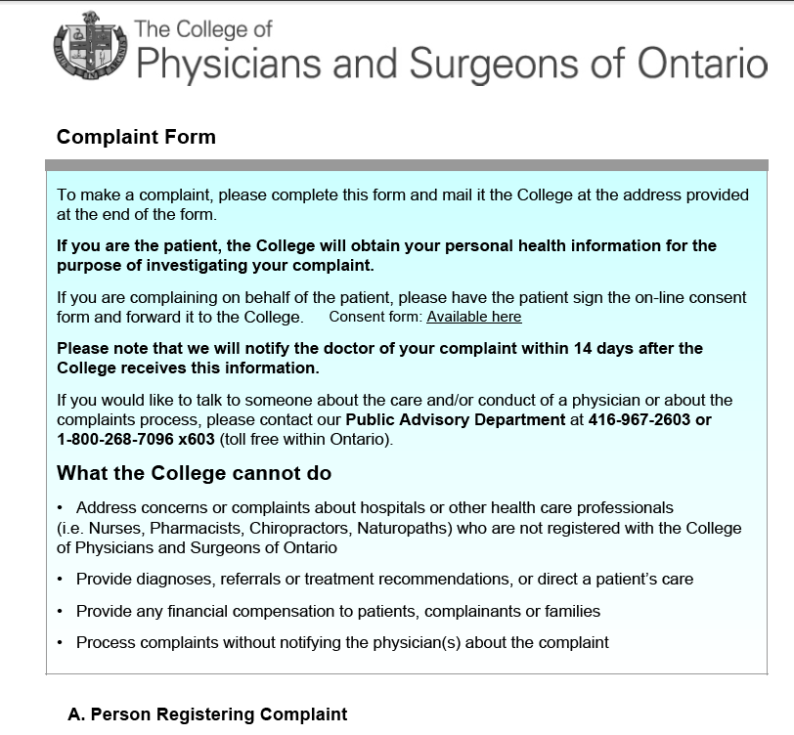

Slide 16
Members

Slide 17
CPSO Public Register
Name Address Phone
Registration Status/Class
Qualifications
Terms, conditions & limitations
Current allegations or previous findings

Slide 18
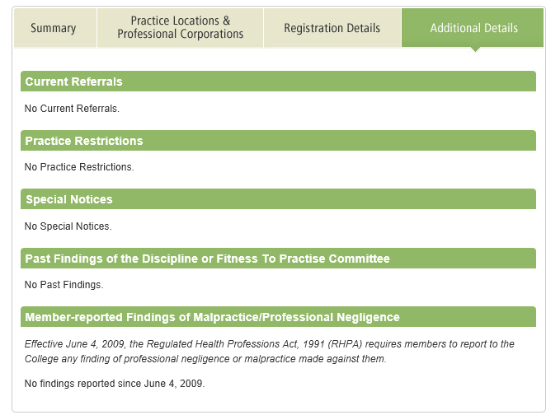
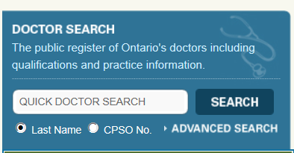

Slide 19
Outcomes

Slide 20
Inquiries, Complaints & Reports Committee (ICRC) - Outcomes
No further action
Written Advice
Specified Continuing Education or Remediation Programs (SCERPs)
Oral Caution
Referral to the Discipline Committee
Interim Suspension

Slide 21
CPSO ICRC Outcomes

Slide 22
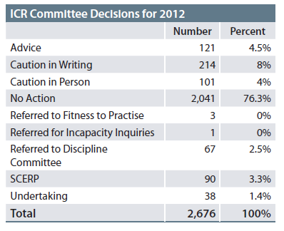
Notes:
Not 67 physicians. Multiple complaints often re number of docs. (highest number of docs referred in a year has been 53).

Slide 23
Discipline (public) 70
Complaints (not public) 2606
Notes:
2012 data

Slide 25
‘patients have no way of finding out from the colleges if their health care providers have been cautioned’
‘…the balance has shifted unnecessarily away from transparency and openness.’
‘…privacy laws are not an excuse to promote secrecy. All too often though, that is exactly what is happening.’

Slide 26
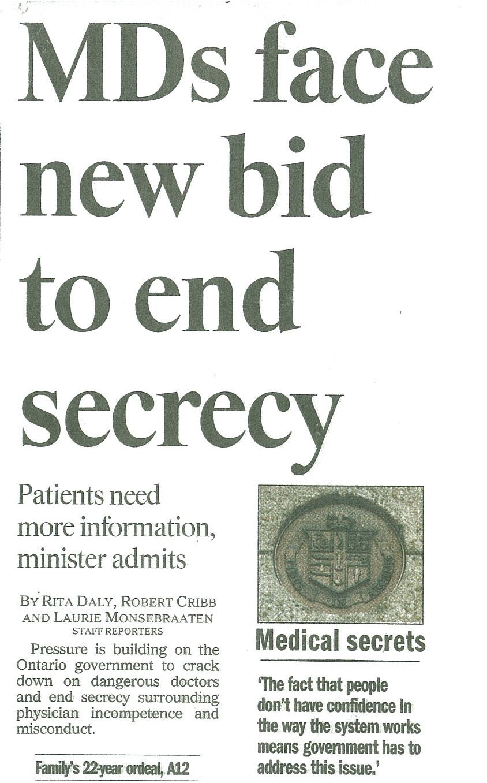
Pressures: Media

Slide 27
Advisory Group for Regulatory Excellence (AGRE)
Physicians
Nurses
Pharmacists
Dentists
Physiotherapists
Optometrists
Colleges of

Slide 28
AGRE Approach
Complex issues need careful consideration
Transparency is not just about member- specific information (processes and outcomes as well)

Slide 29
AGRE Transparency Project
Recommendations
Transparency Principles
2013
2014

Slide 30
Transparency Principles
Public trust requires information
More information improves choice and accountability
Information should support #2
How the information is provided matters

Slide 31
Transparency Principles
Remediation protects the public and requires confidentiality
Balance*
More risk requires more transparency
Consistency

Slide 32
Phase 1: Member-specific recommendations
Information to be made public:
Date of referral to DC
DC Status
Full Notice of Hearing
Criminal findings of guilt (if relevant)
Bail conditions (if relevant)
Non-members practising illegally

Slide 33
Phase 1: General Recommendations
Enhanced info on websites
Info available on website ASAP
Consistent approach to #/names of ICRC outcomes and definitions/criteria
External review of register search function to evaluate clarity of info and ease of search

Slide 34
Phase 2: Member-specific Recommendations
Information to be made public:
Names of former members
Health facility privileges
Criminal charges (if relevant)
Licences – other jurisdictions (if known)
Discipline findings – other jurisdictions (if known)
Discipline Committee – no findings

Slide 35
Phase 2: Member-specific Recommendations
Undertakings
ICRC: Oral cautions
ICRC: SCERPS

Slide 36
Phase 2: General Recommendation
Increased focus on data analysis to inform regulatory activities and public reporting

Slide 37
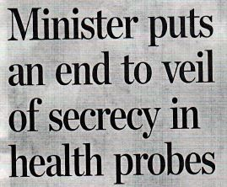
Media

Slide 38
Minister’s Letter – Oct 4, 2014
Make transparency a priority
Take steps to develop and establish measures that will continuously increase transparency in College processes and decision-making
Strengthen existing measures
New measures to increase transparency

Slide 39
Next Steps
Responses to Minister by Dec 1/14
Usability review of CPSO register functions to be completed by end 2014
Implementation of recommendations in 2015

Slide 40
Website Goals
Creating meaningful links within the site
Making information intuitive, easy to find, clear and easy to understand
Plain language (easier said than done)

Slide 41
www.cpso.on.ca

