Slide 1
SOAR 2014 Annual Conference Access To Justice: Change The Culture, Shift the Paradigm Presented by: Kwame Addo November 6, 2014
Making Regulatory Processes More Accessible and Transparent

Slide 2
Background
In 2006, province enacted City of Toronto Act
Act established four mandatory accountability officers, including Ombudsman
Ombudsman appointed in 2008
Office open to the public in April 2009

Slide 3
It’s a Balancing Act

Slide 4
Relevant legislation
City of Toronto Act (sections 170- 176)
Ombudsman Act (s. 19)
Toronto Municipal Code, Chapter 3
Section 3-30 (A)
Section 3-34 (B)
Section 3-35 (A)
Section 3-37

Slide 5
City of Toronto Act
Investigations must be conducted in private
Ombudsman and staff shall preserve secrecy
Ombudsman may disclose in any report, information in her opinion that ought to be disclosed in order to establish grounds for his or her conclusions and recommendations

Slide 6
City of Toronto Act
Ombudsman files are exempt from MFIPPA
Ombudsman or anyone working under the instruction of the Ombudsman cannot be compelled to give evidence in a court proceeding

Slide 7
Municipal Code Chapter 3
Own motion investigations
Inform the complainant in writing if the Ombudsman refuses to investigate or discontinue an investigation
After investigation, inform complainant in writing of the results
Inform other affected parties

Slide 8
Additional confidentiality measures
Emails
Third party inquiries

Slide 9
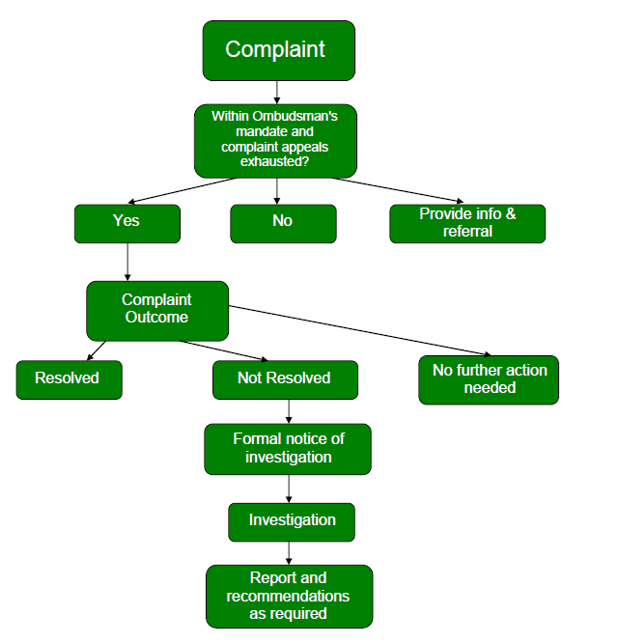
Source: Working With The Ombudsman: A Guide for the Toronto Public Service. September 2013

Slide 10
Making our processes more accessible and transparent

Slide 11
Accessing COT Ombudsman
Municipal Code allows Ombudsman to determine procedures
Flexible
Complaint doesn’t have to be in writing
Mail, in-person, on-line/email, phone

Slide 12
During the review/investigation
Regular contact with the complainant
Advise in general terms of progress
Anticipated completion date

Slide 13
After the evidence has been gathered
Complainants and the government organization are made aware of the information that will form the basis for the Ombudsman’s decision
Parties given an opportunity to respond and/or provide any new information
Reasons given to explain decisions and conclusions

Slide 14
Release of Investigation Reports
Reports will inform the complaint and the gov’t organization of the results of investigation
Must comply with s. 173(1)
Complainant’s name and all other identifying information redacted before release

Slide 15
Release of reports
Report is tabled with City Council, relevant division, ABCC before release to the public
Criteria for release of investigation report
Public interest issue
Systemic or system-wide implications

Slide 16
Helping the public and TPS understand the Ombuds process
Publications
Working with the Ombudsman: Protocol for TPS
Defining Fairness
Annual Report

Slide 20
Improving access
Website
Plain language text
Compliant with web standards recommended by web accessibility initiative
On-line reports available in alternative formats
On-line complaint form
TTY capability for hearing impaired individuals

Slide 21
Improving access
Public education
Demographic survey
Time lines

Slide 22
⬧
Questions

