Slide 1

Supporting
self-represented people
Presentation for the Society of Adjudicators and Regulators
November 3, 2016
Notes:
1

Slide 2
Who is CLEO?
A public legal education and information (PLE) organization, 40-years old, with provincial mandate
Multiple long- and short-term funding sources
  Long-term funders include LAO, DOJ, and LFO
Hallmarks of CLEO’s work:
  Legal accuracy
  Clear language and design
  Reflects real-world experience
  Focus on needs of marginalized/ low-income people
2
Notes:
2

Slide 3
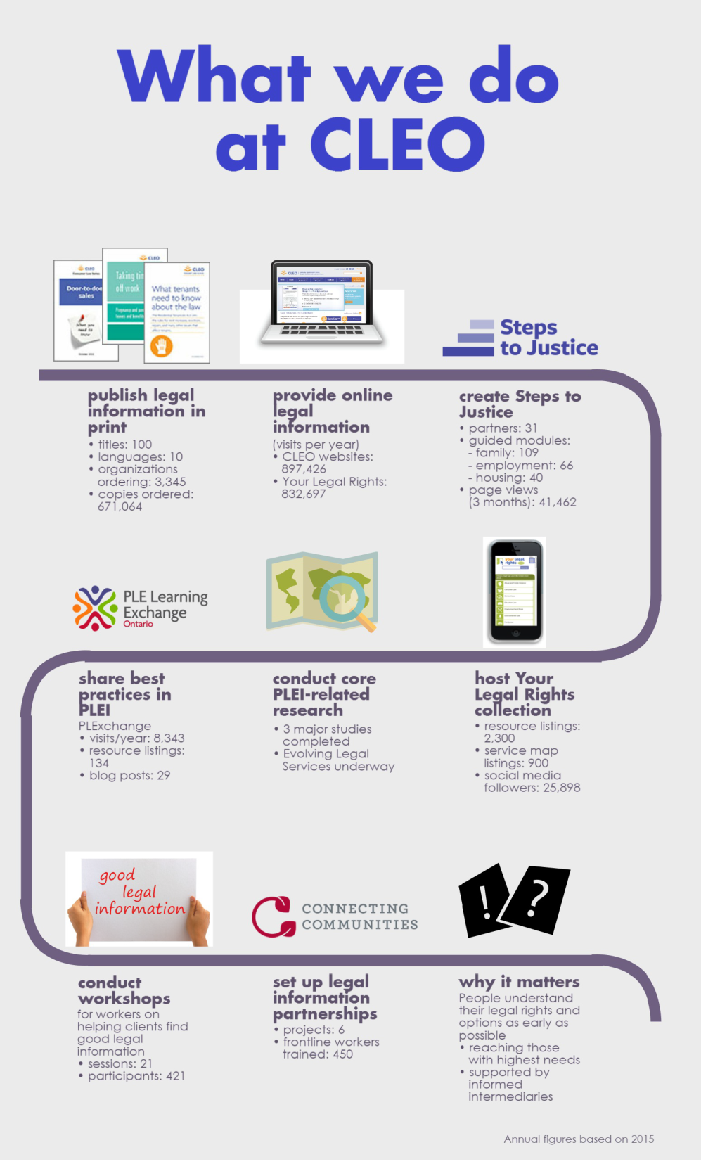

Slide 4
CLEO’s publications work
Produce and disseminate high-quality legal information, in [free] print and online
  100 titles
  10 languages
  Print copies ordered and distributed by community and legal organizations across Ontario
  www.cleo.on.ca

Slide 5
CLEO: supporting PLEI in Ontario
Carries out range of activities through CLEO’s “Centre for Research & Innovation”
  Shares and builds knowledge through the PLE Learning Exchange
  Carries out foundational PLEI research
  Supports intermediaries and building partnerships
  Proposes and carries out special projects

Slide 6
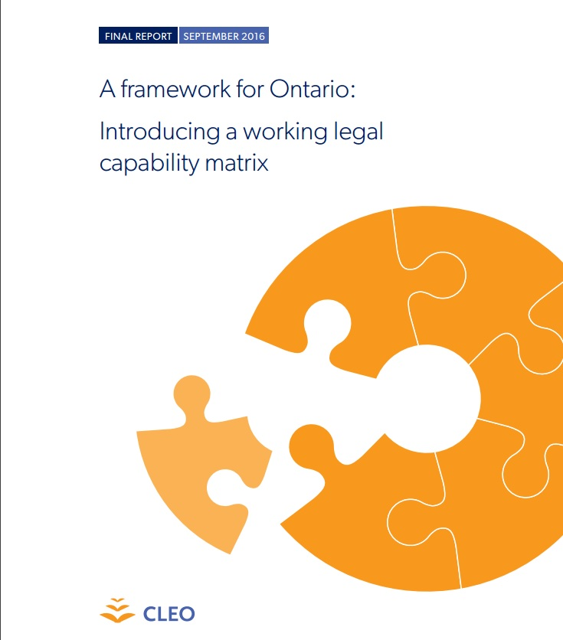

Slide 7
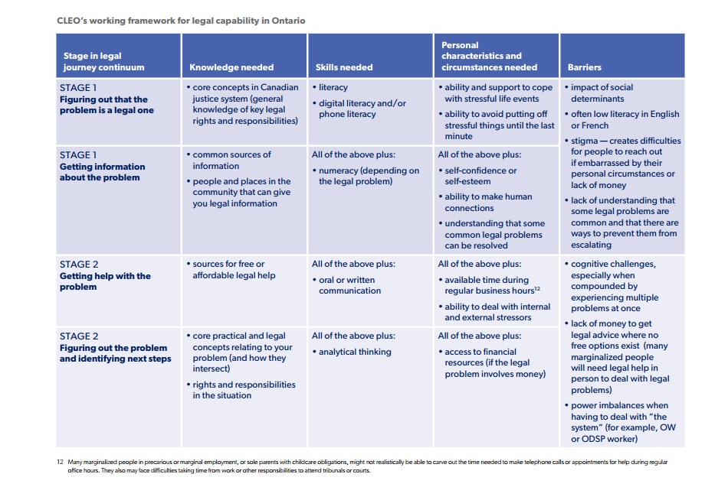

Slide 8
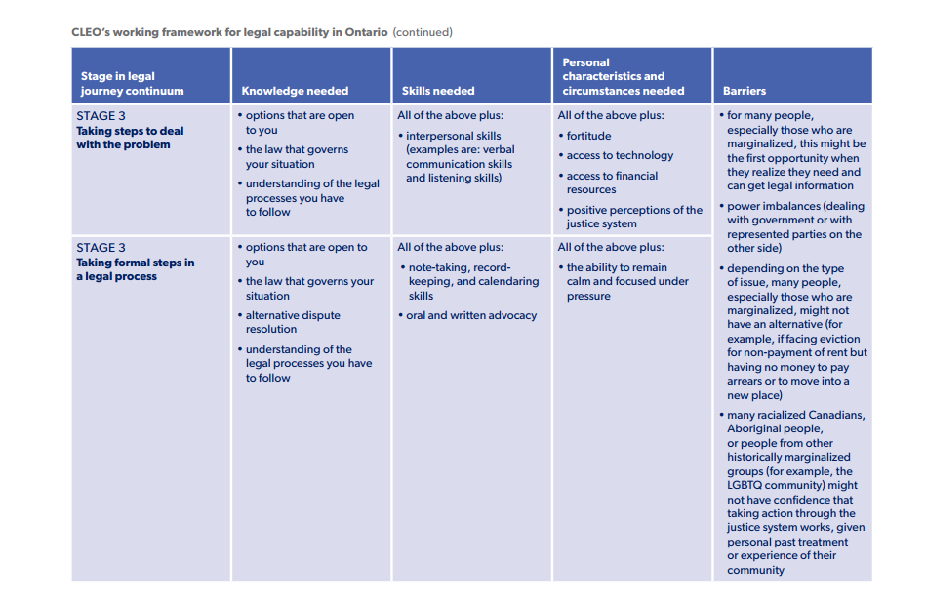

Slide 9
Introducing Steps to Justice
Signature initiative of The Action Group on Access
  Impetus for partnership-building and collaboration
Collaborative project of major justice sector organizations
Content builds on and existing resources
Co-brand conveys reliability and quality
Updated content will be automatically available through numerous entry points – no “wrong door”

Slide 10



















Slide 11
11
Notes:
11

Slide 12
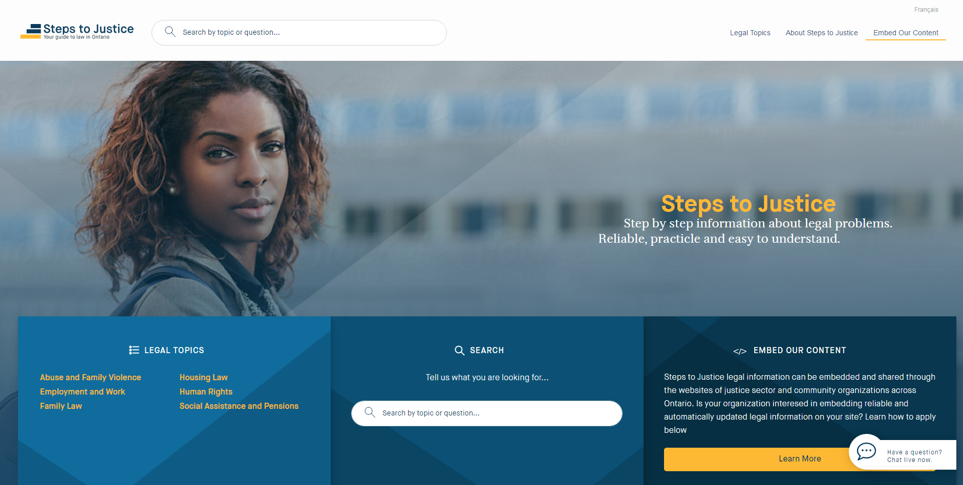
12
Notes:
12

Slide 13
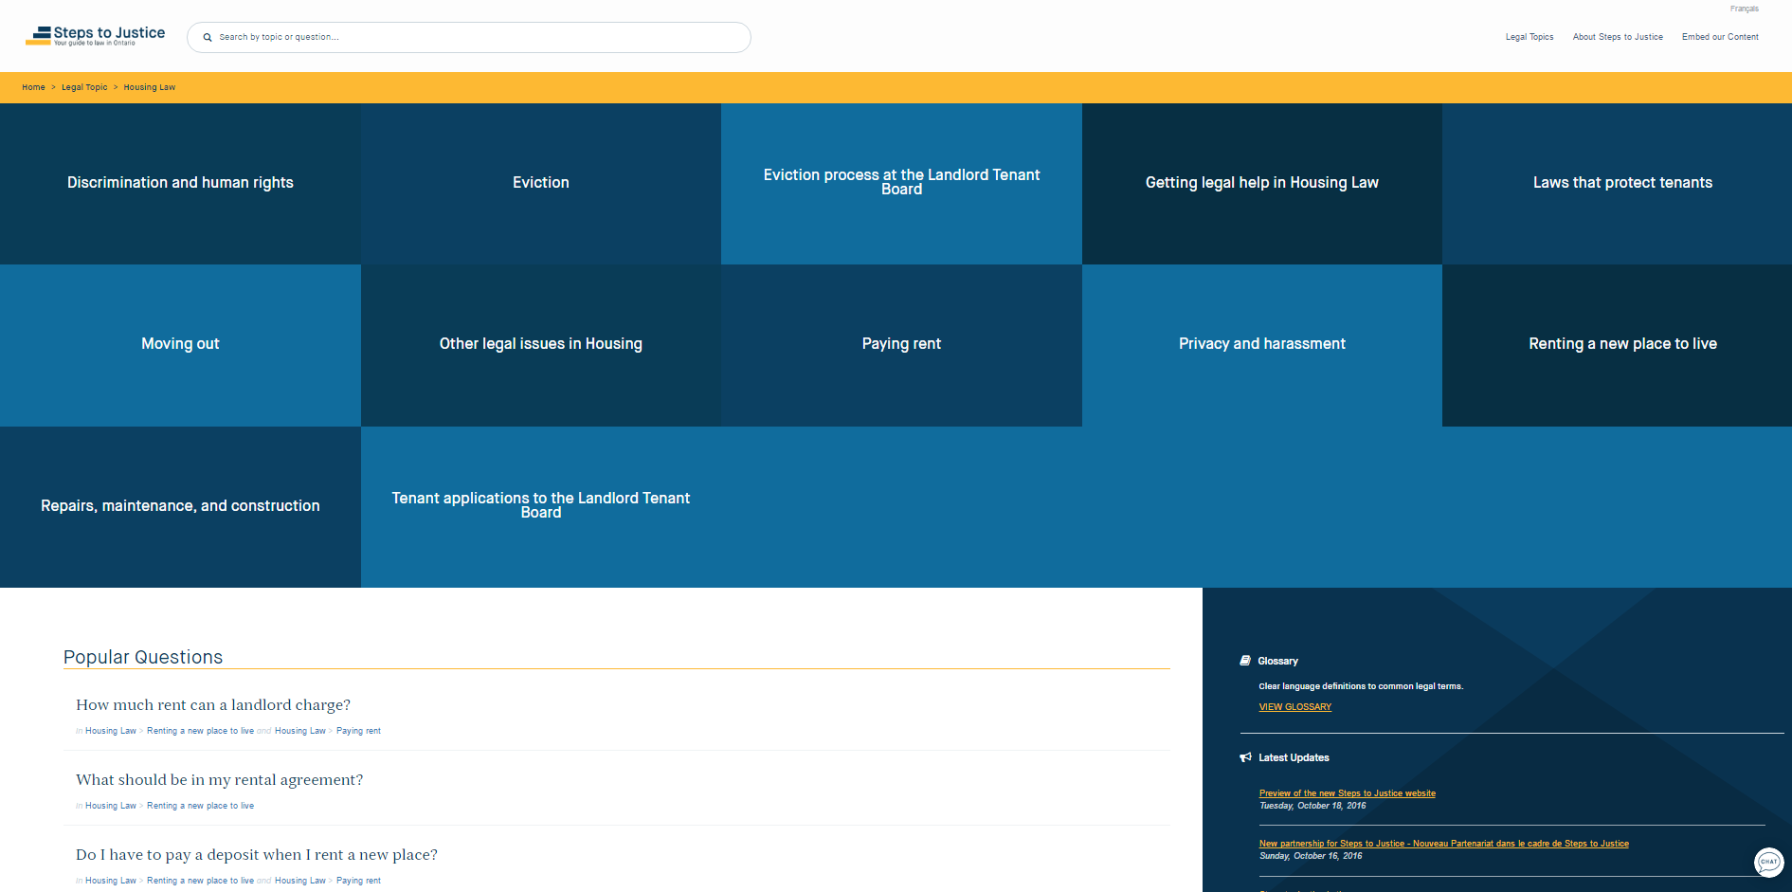
13
Notes:
13

Slide 14
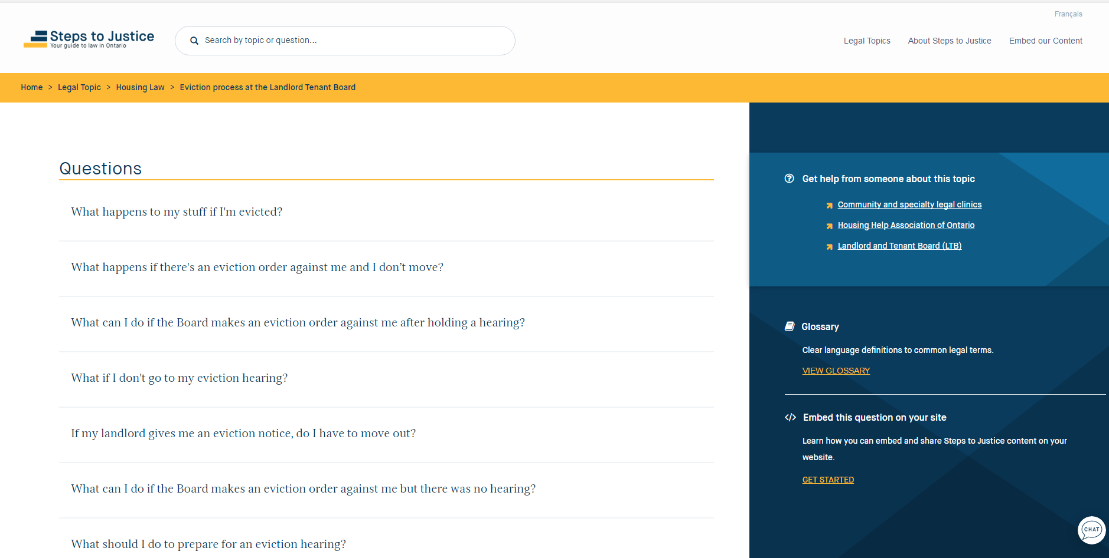
14
Notes:
14

Slide 15
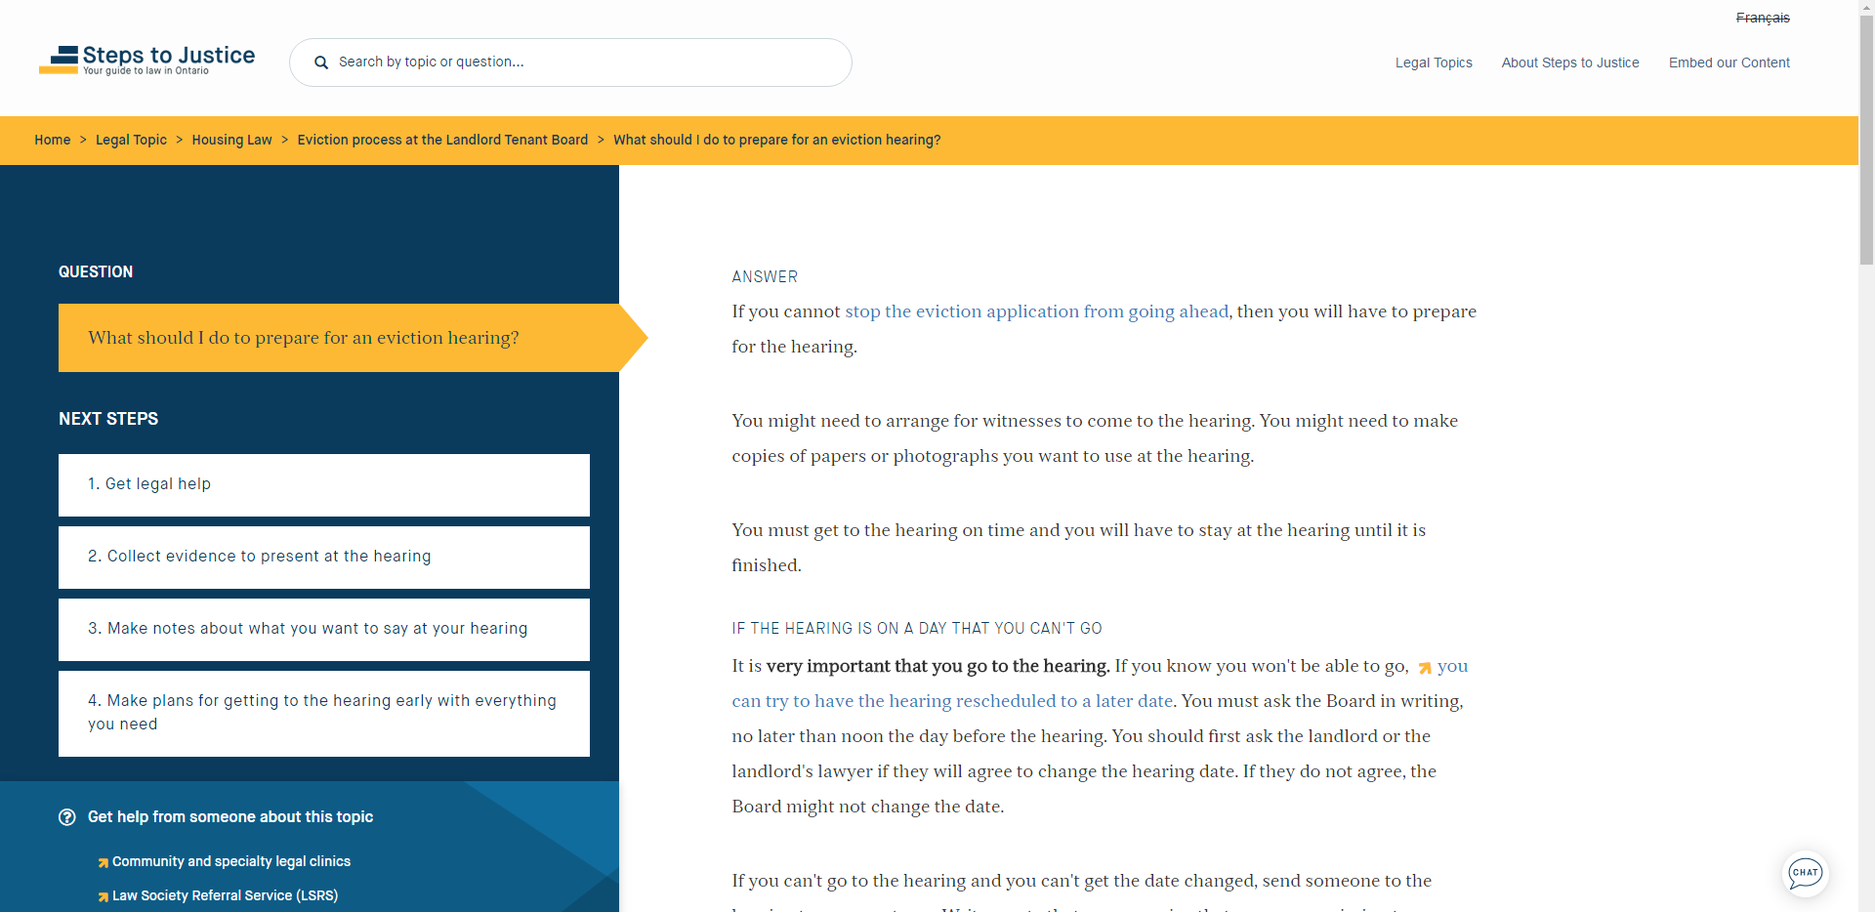
15
Notes:
15

Slide 16
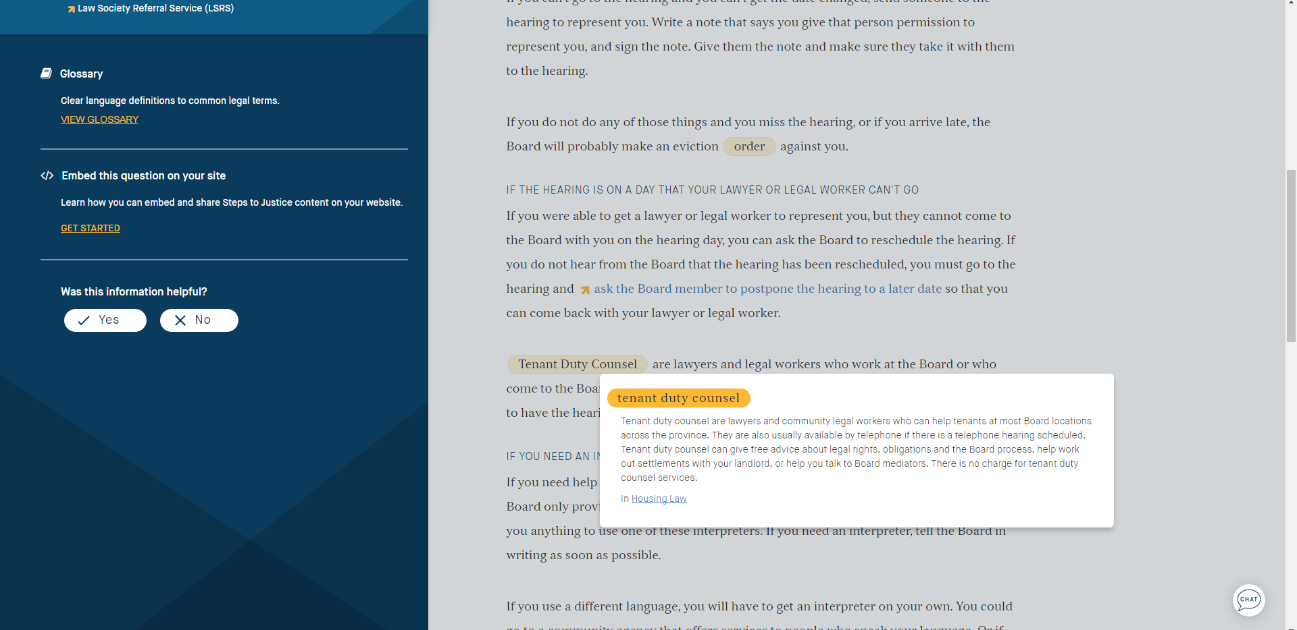
16
Notes:
16

Slide 17
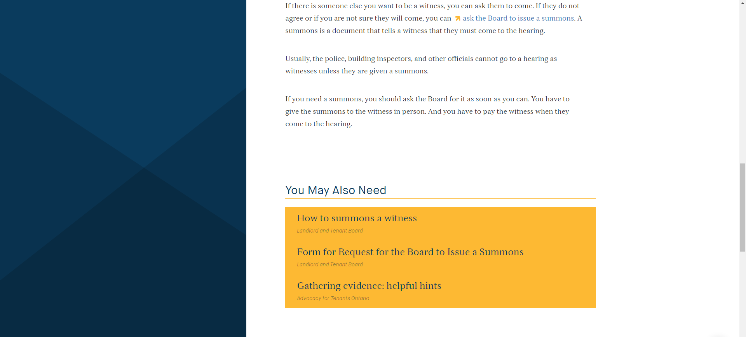
17
Notes:
17

Slide 18
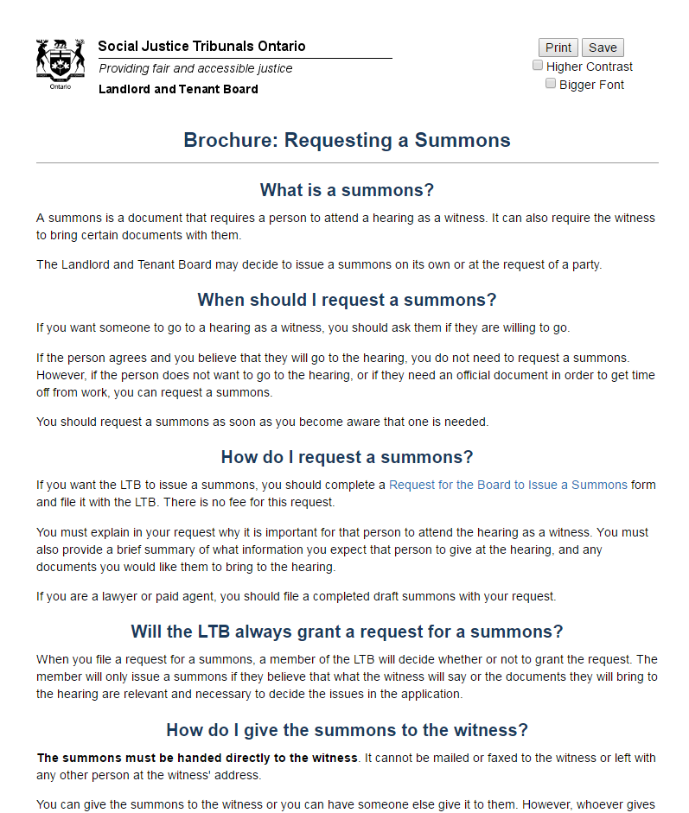
18
Notes:
18

Slide 19
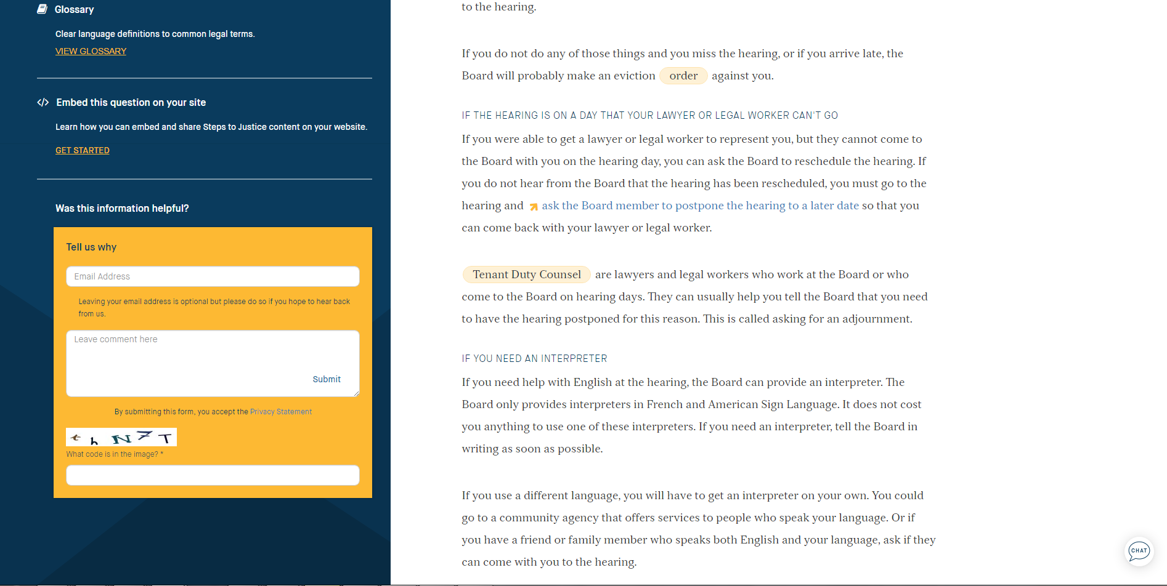
19
Notes:
19

Slide 20
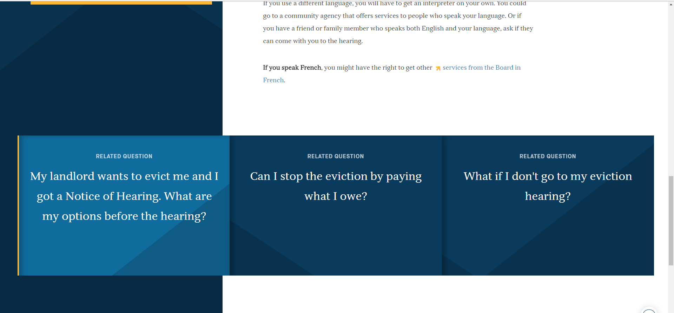
20
Notes:
20

Slide 21
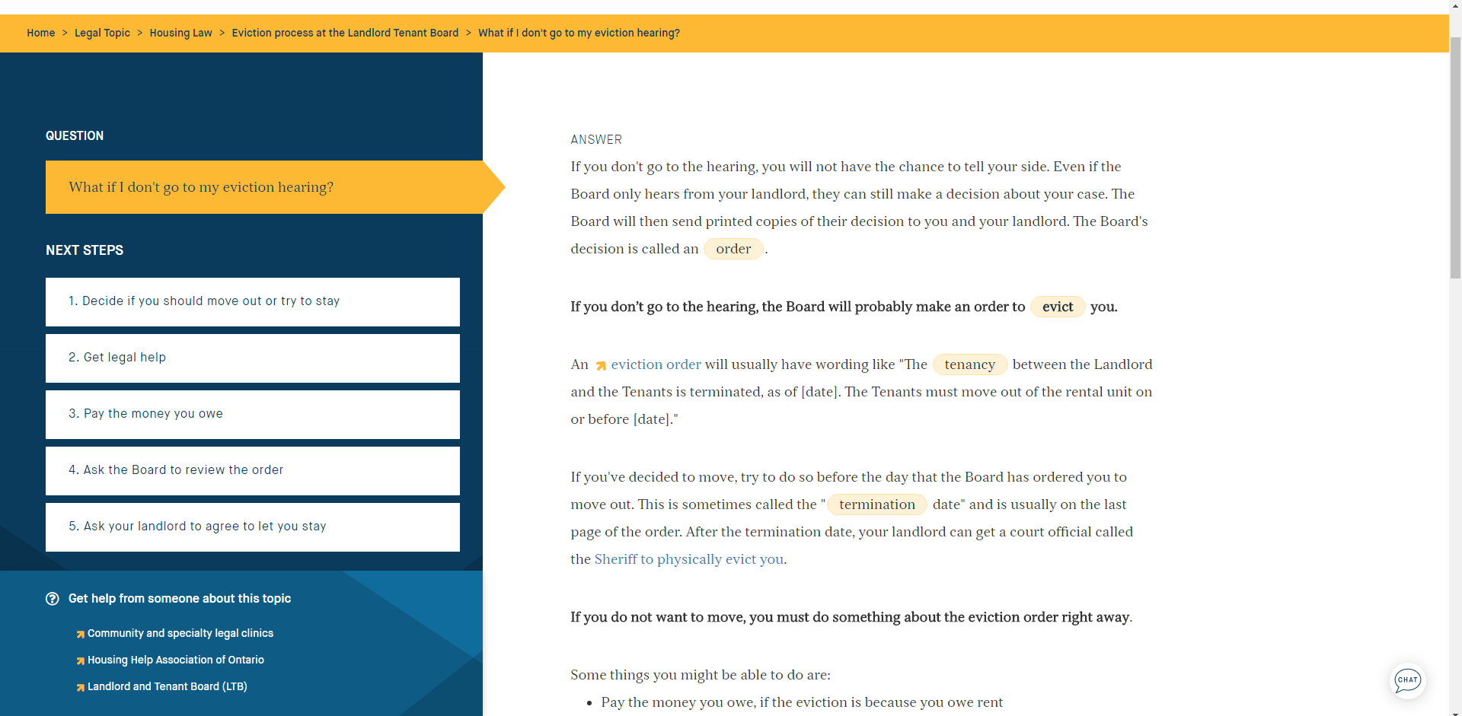
21
Notes:
21

Slide 22
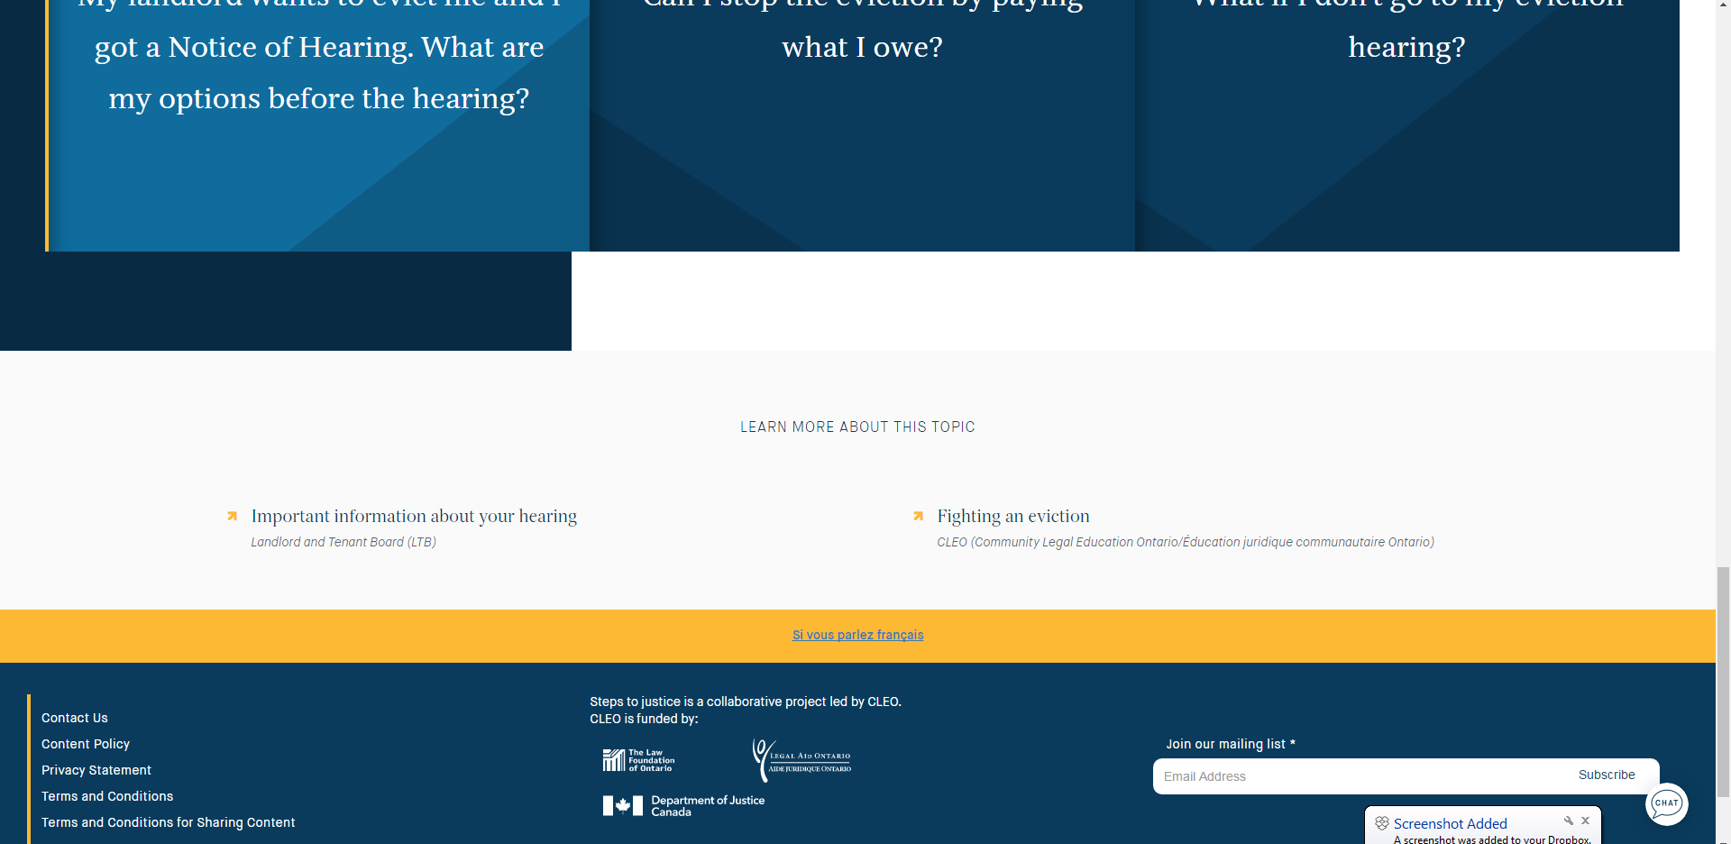
22
Notes:
22

Slide 23
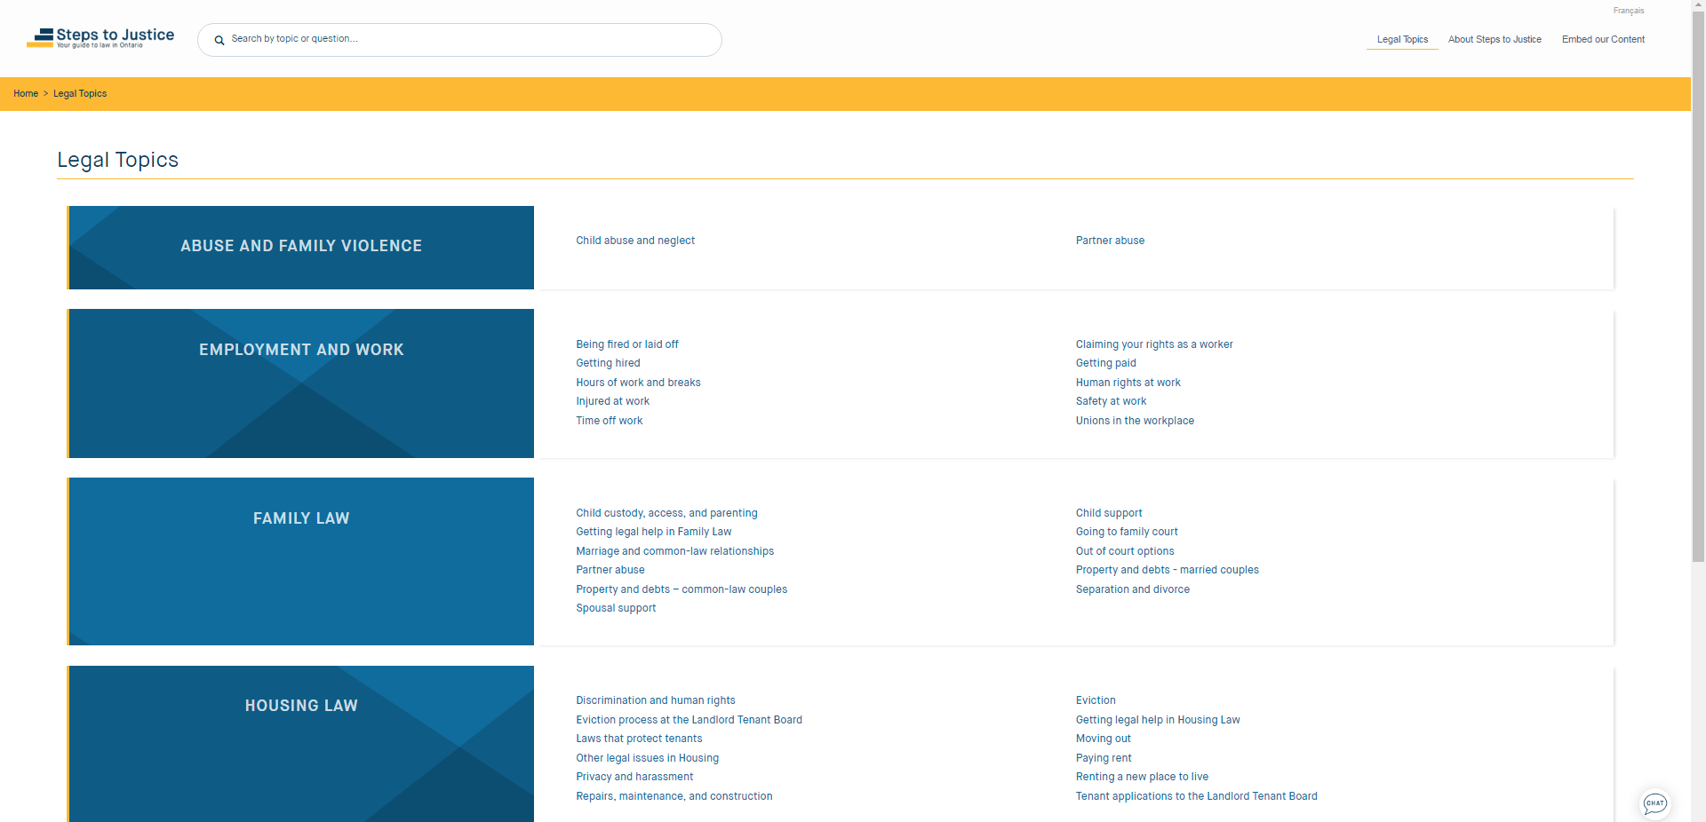
23
Notes:
23

Slide 24
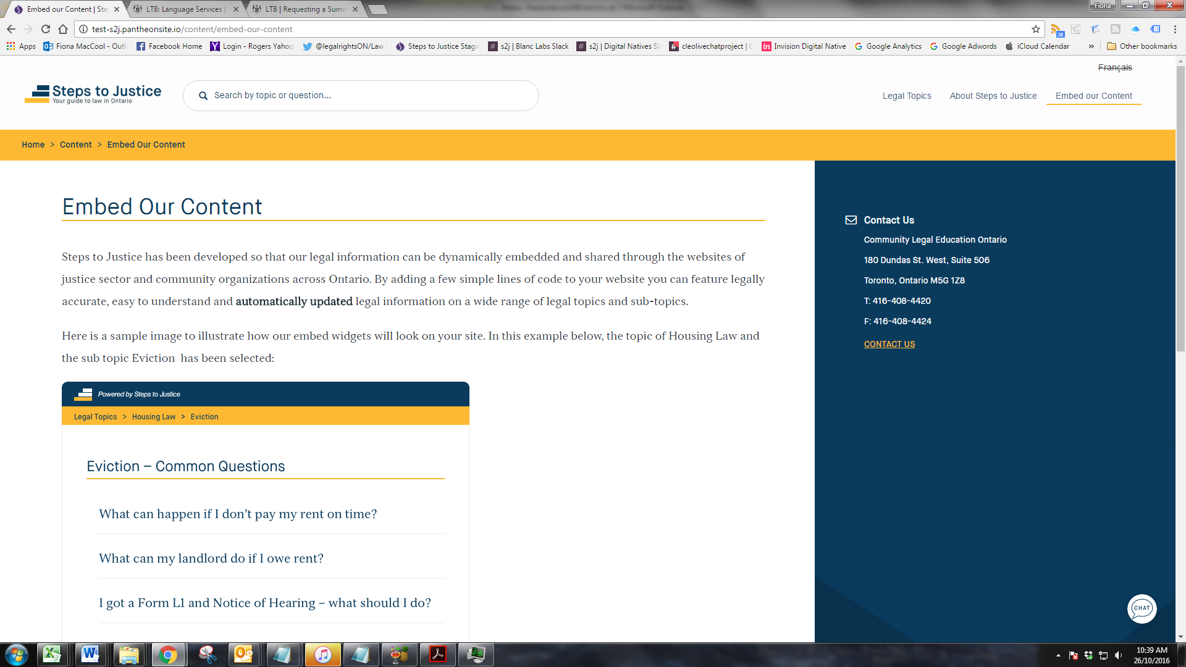
24
Notes:
24

Slide 25
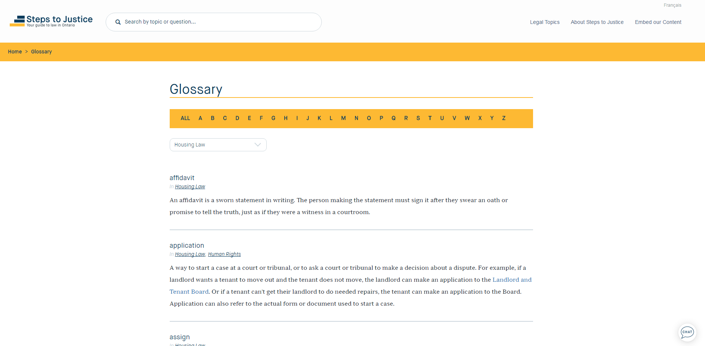
25
Notes:
25

Slide 26
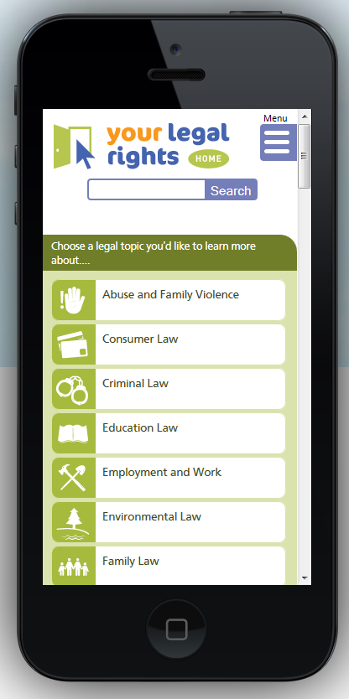


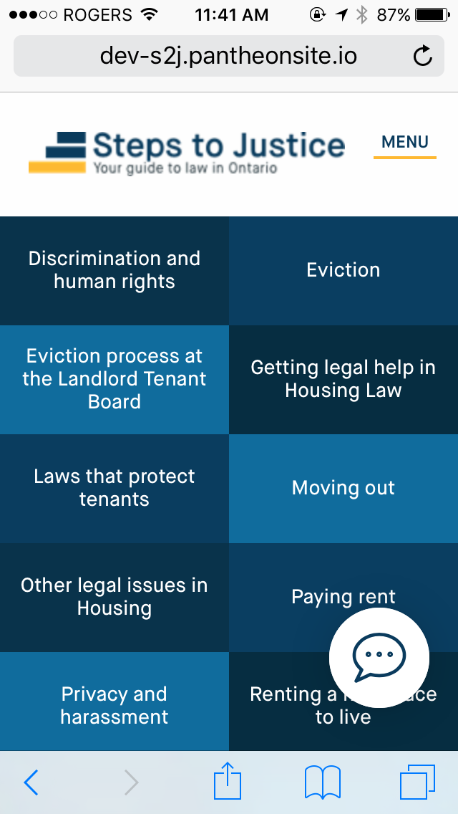
Mobile
Responsive
  Content automatically responds to user display settings, displaying content in a 1 or 2 column with key elements following one another
26

Slide 27
Structure of Content
List of sub-topics within each area of law
7-15 common questions within each sub-topic
Each question & answer is comprised of:
    Answer
    Next steps: 3-5 concrete practical steps to guide the user
    You may need: links to forms, templates, checklists, referral information, etc.
    Related questions
    Get help from someone
    Learn more
Glossary

Slide 28
Sharing Options
To enable others to embed this information on their websites
Flexible options re: what each website can feature, level of detail
Automatically updated embedded content fed into external websites to ensure accuracy and currency

Slide 30
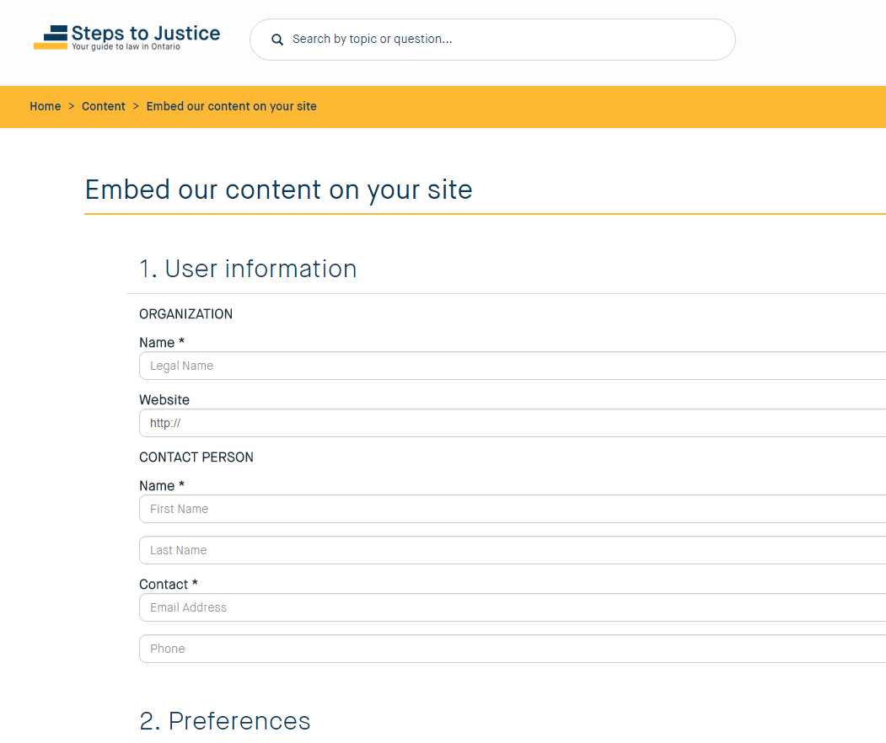

Slide 31
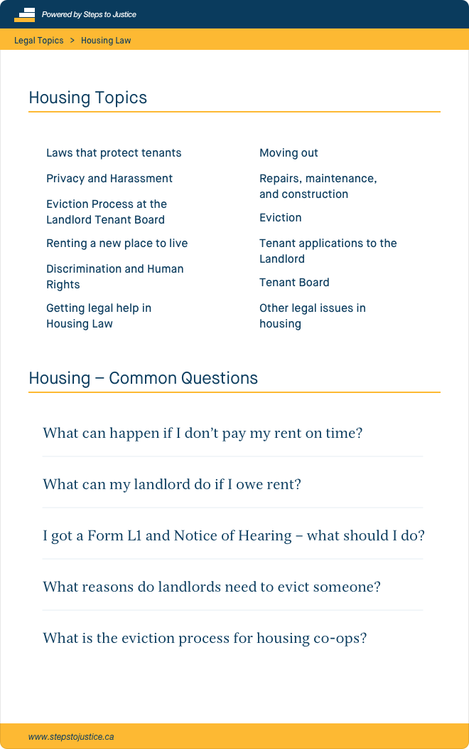

An example of how a Legal Topic Embed for Housing Law would look

Slide 32
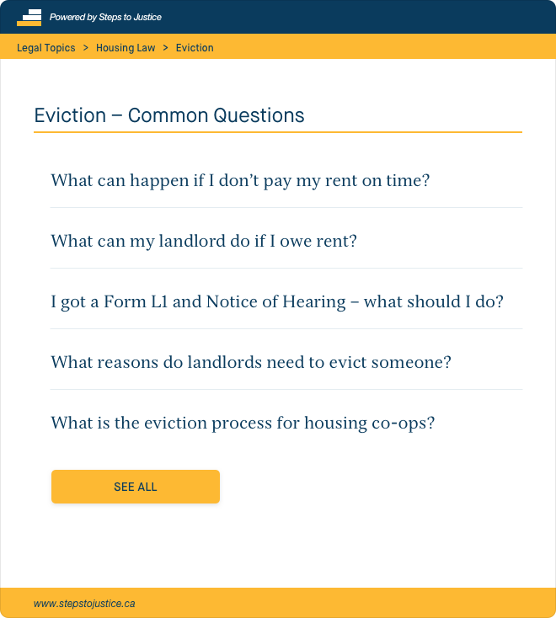
An example of how a Legal Topic – Sub Topic embed for Housing Law - Eviction would look

Slide 33

An example of how a full question embed would look

Slide 34
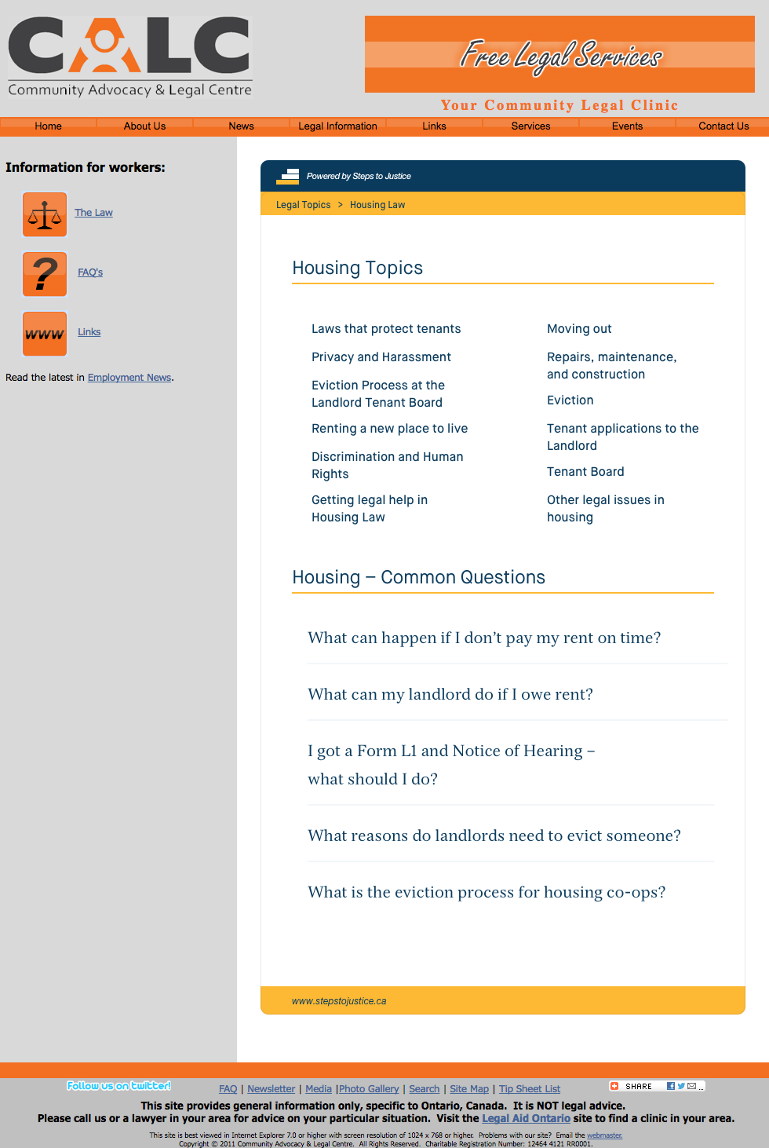
An example of how content embeds look on other websites

Slide 35
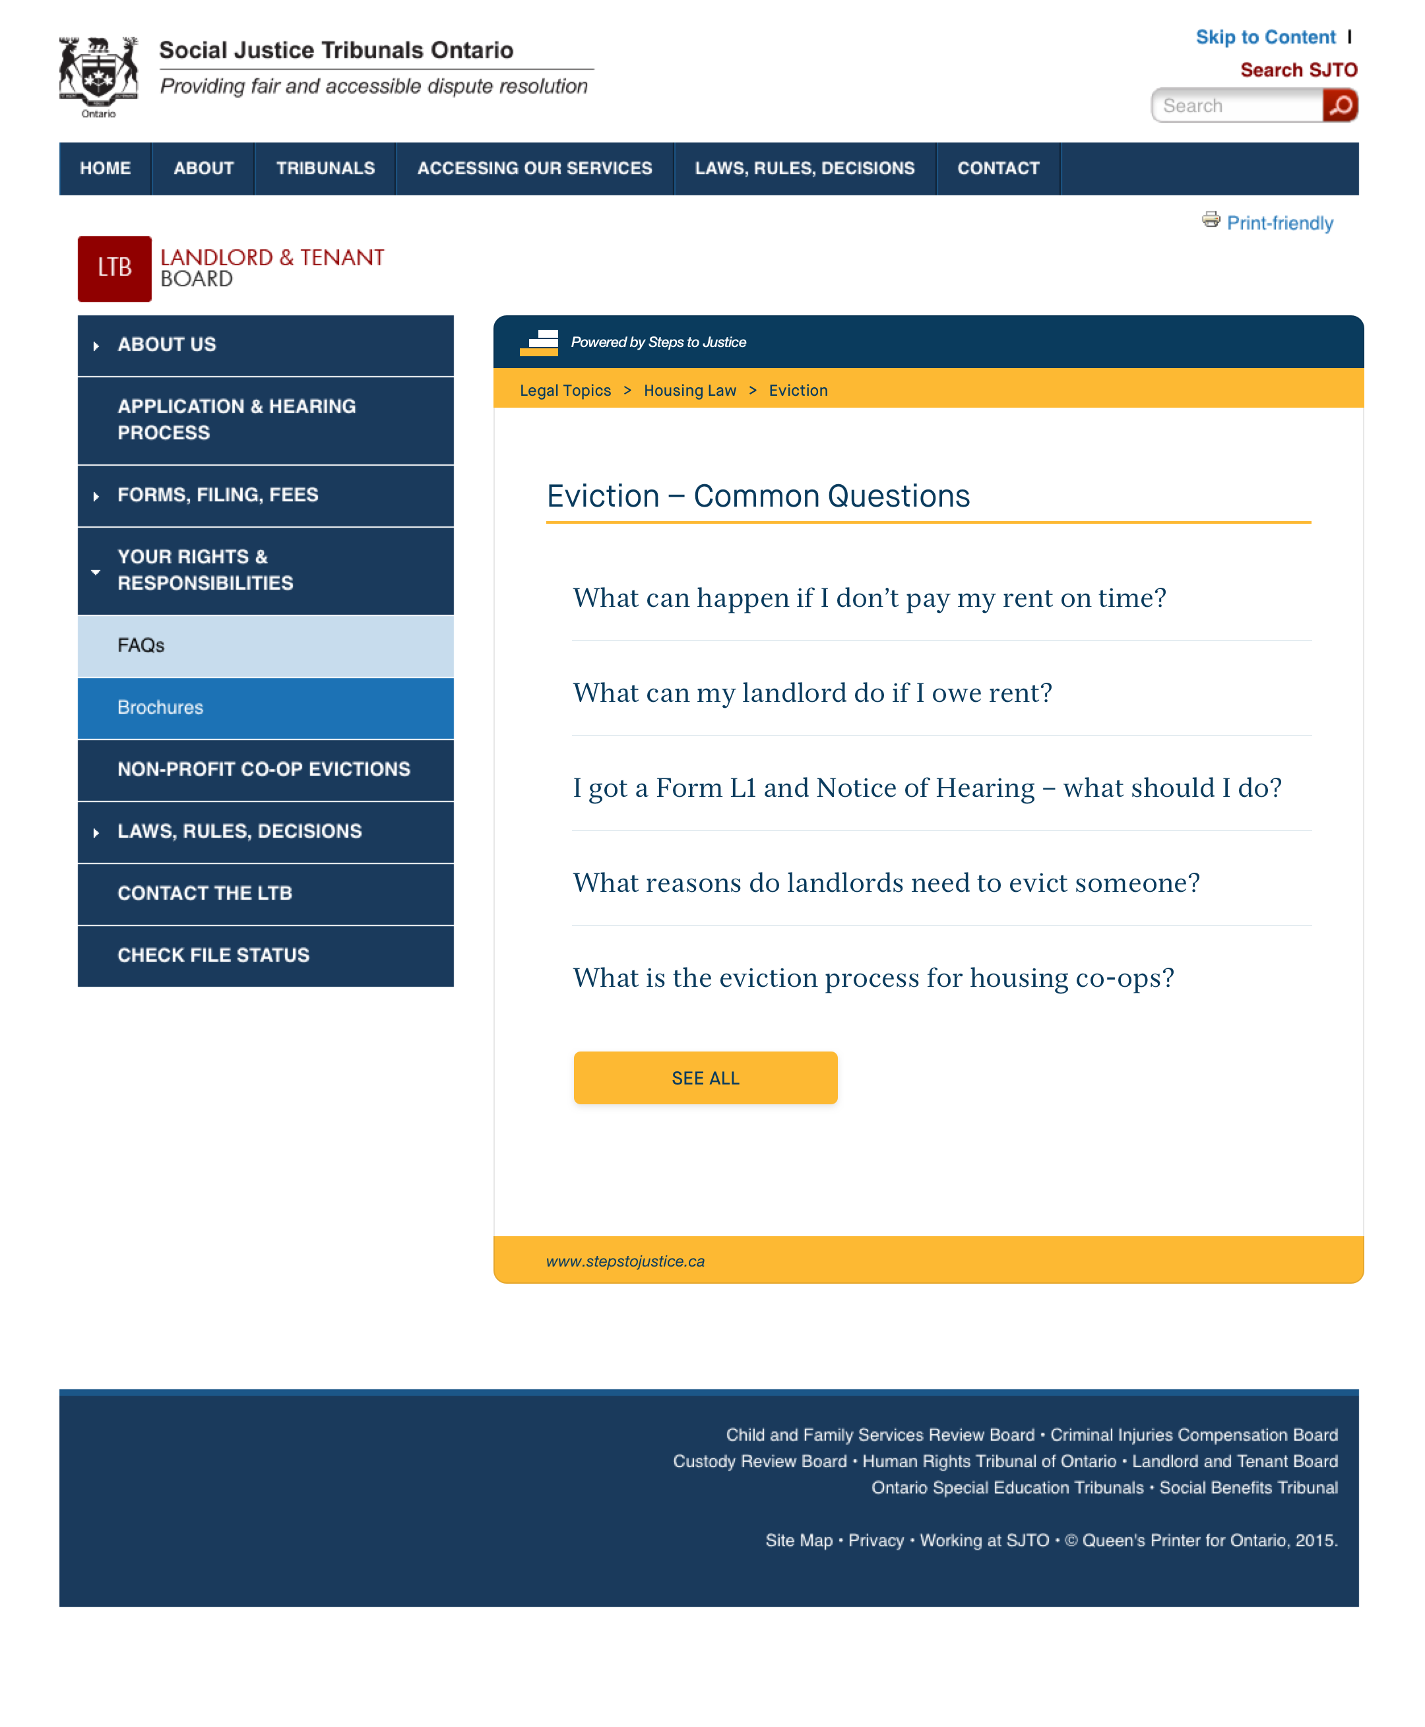
An example of how content embeds look on other websites

Slide 36
Recap: So, What’s New?
At core: reliable and concrete “practical next steps”, with links to forms, templates, checklists, referral information, etc.
Collaborative website – working together rather than in silos
Co-branding with stakeholders to convey reliability and quality
Make automatically updated content available through numerous entry points – no “wrong door”

Slide 37
Guiding Principles for Content
User-based – topics, writing level, design, navigation
Concrete “next steps” – process oriented, things to think about, things that can happen, etc.
Conversational, engaging tone – speak directly to user as “you”
Adhere to common style guide
Adopt process for regular review and updates
37
Notes:
37

Slide 38
Collaborative Structure
Content committee(s)
Ensure the taxonomy includes:
  Key topic areas
  High demand issues and practical concerns for the user
  Review taxonomy every six months
Identify content reviewers and developers (on specific topics)
Members to represent diverse (user-based) perspectives, regional diversity, legal experts from all sectors
38

Slide 39
Collaborative Structure
Content reviewers and developers
Review content of “answers” and next steps for:
  legal accuracy
  “real-world” accuracy (for intended users)
  practical relevance of next steps
  appropriateness of related resources
  up-to-date and quality referral information
Draft initial content in particular topic areas of expertise
Periodic accuracy check-ins; process to stay abreast of “under the radar” changes
39

Slide 40
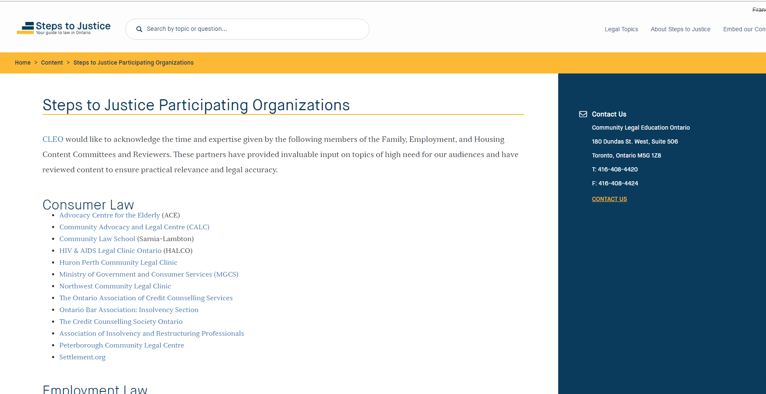
40

Slide 41
Next Steps
Developing content in consumer, social assistance, refugee law
User testing to get feedback on:
  Design of the site
  Comprehension of the content
Increase interactivity
  Decision trees to allow people to find information more easily
Translation
41

Slide 42
Thank you
Julie Mathews
CLEO (Community Legal Education Ontario)
julie.mathews@cleo.on.ca
www.cleo.on.ca
42
Notes:
42

