Slide 1
Workshop #1: Living in the Future of Online Dispute Resolution – The Condominium Authority Tribunal
Soar Annual conference 2018 - September 27, 2018
Presented by:
Ian Darling, Chair, Condominium Authority Tribunal
Keegan Ferreira, Deputy Registrar & Director, Tribunal Operations,
Condominium Authority of Ontario

Slide 2
COMPLEX ISSUES, INNOVATIVE APPROACH

Slide 3
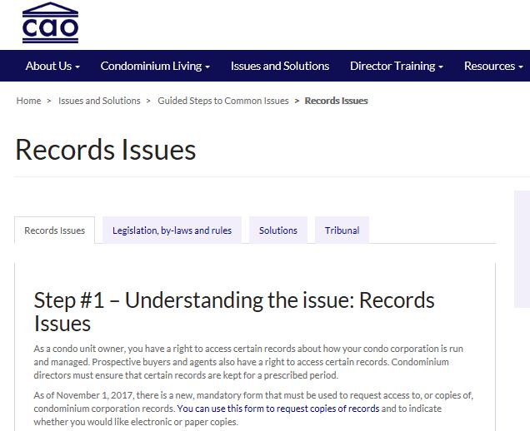
guided steps

Slide 4
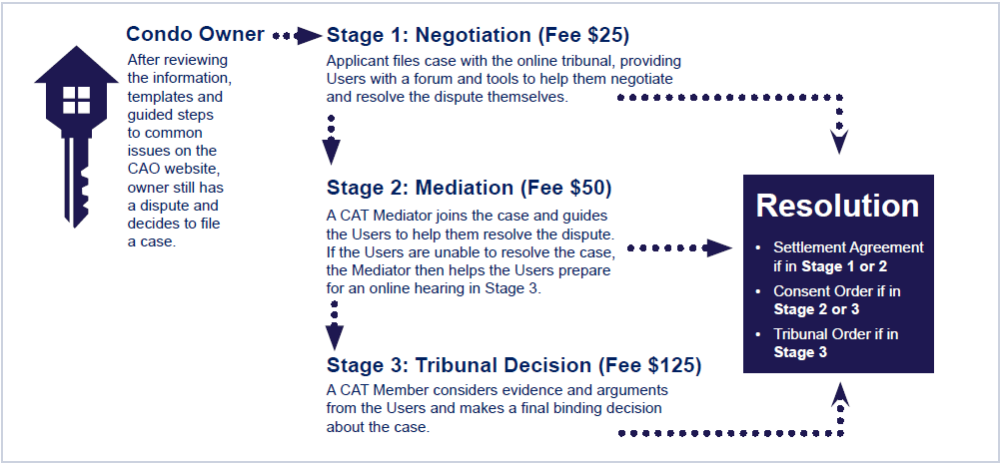
CANADA’s first fully online tribunal

Slide 5
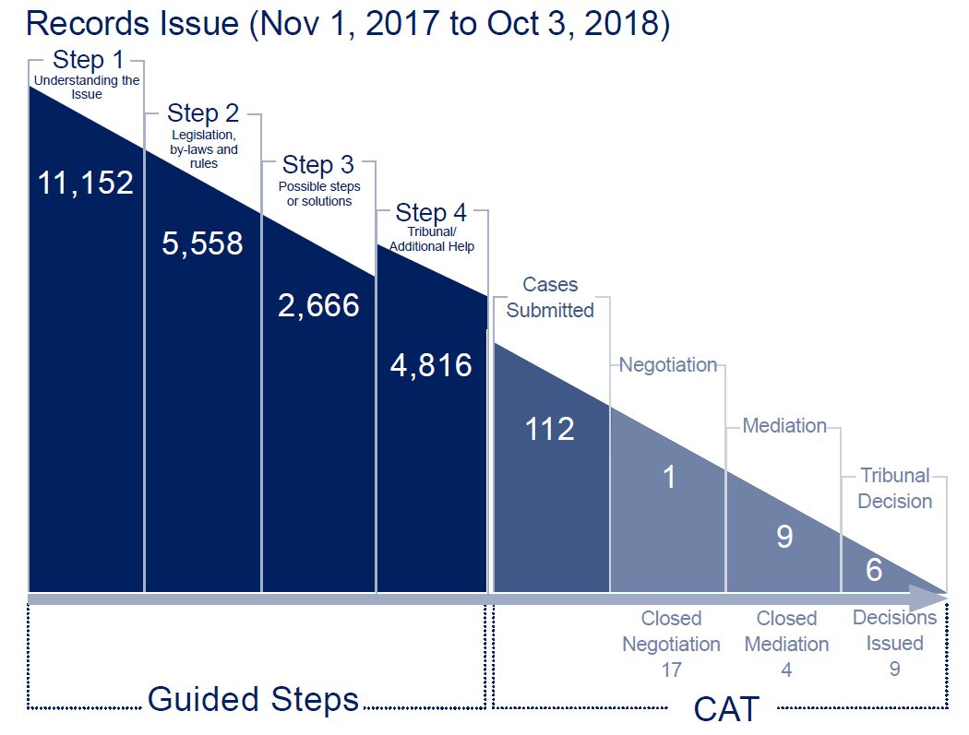
Integrated Issue and dispute resolution results

Slide 6
The five principles
Fair
Timely
Participatory
Accessible
Predictable

Slide 7
What’s Ahead
Multi-party disputes
Witness portal
Integrated audio/videoconferencing
Combining and severing cases
Expanded analytics

