Slide 1
Stakeholder Engagement
SOAR ANNUAL CONFERENCE November 14, 2024
David Smith Director, External Relations

Slide 3
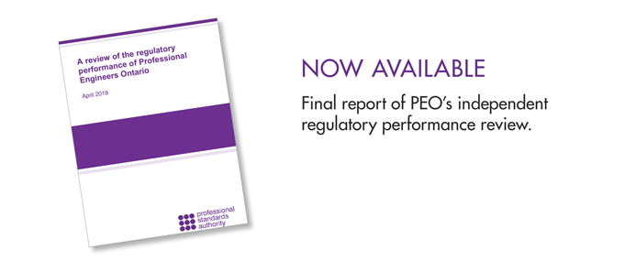
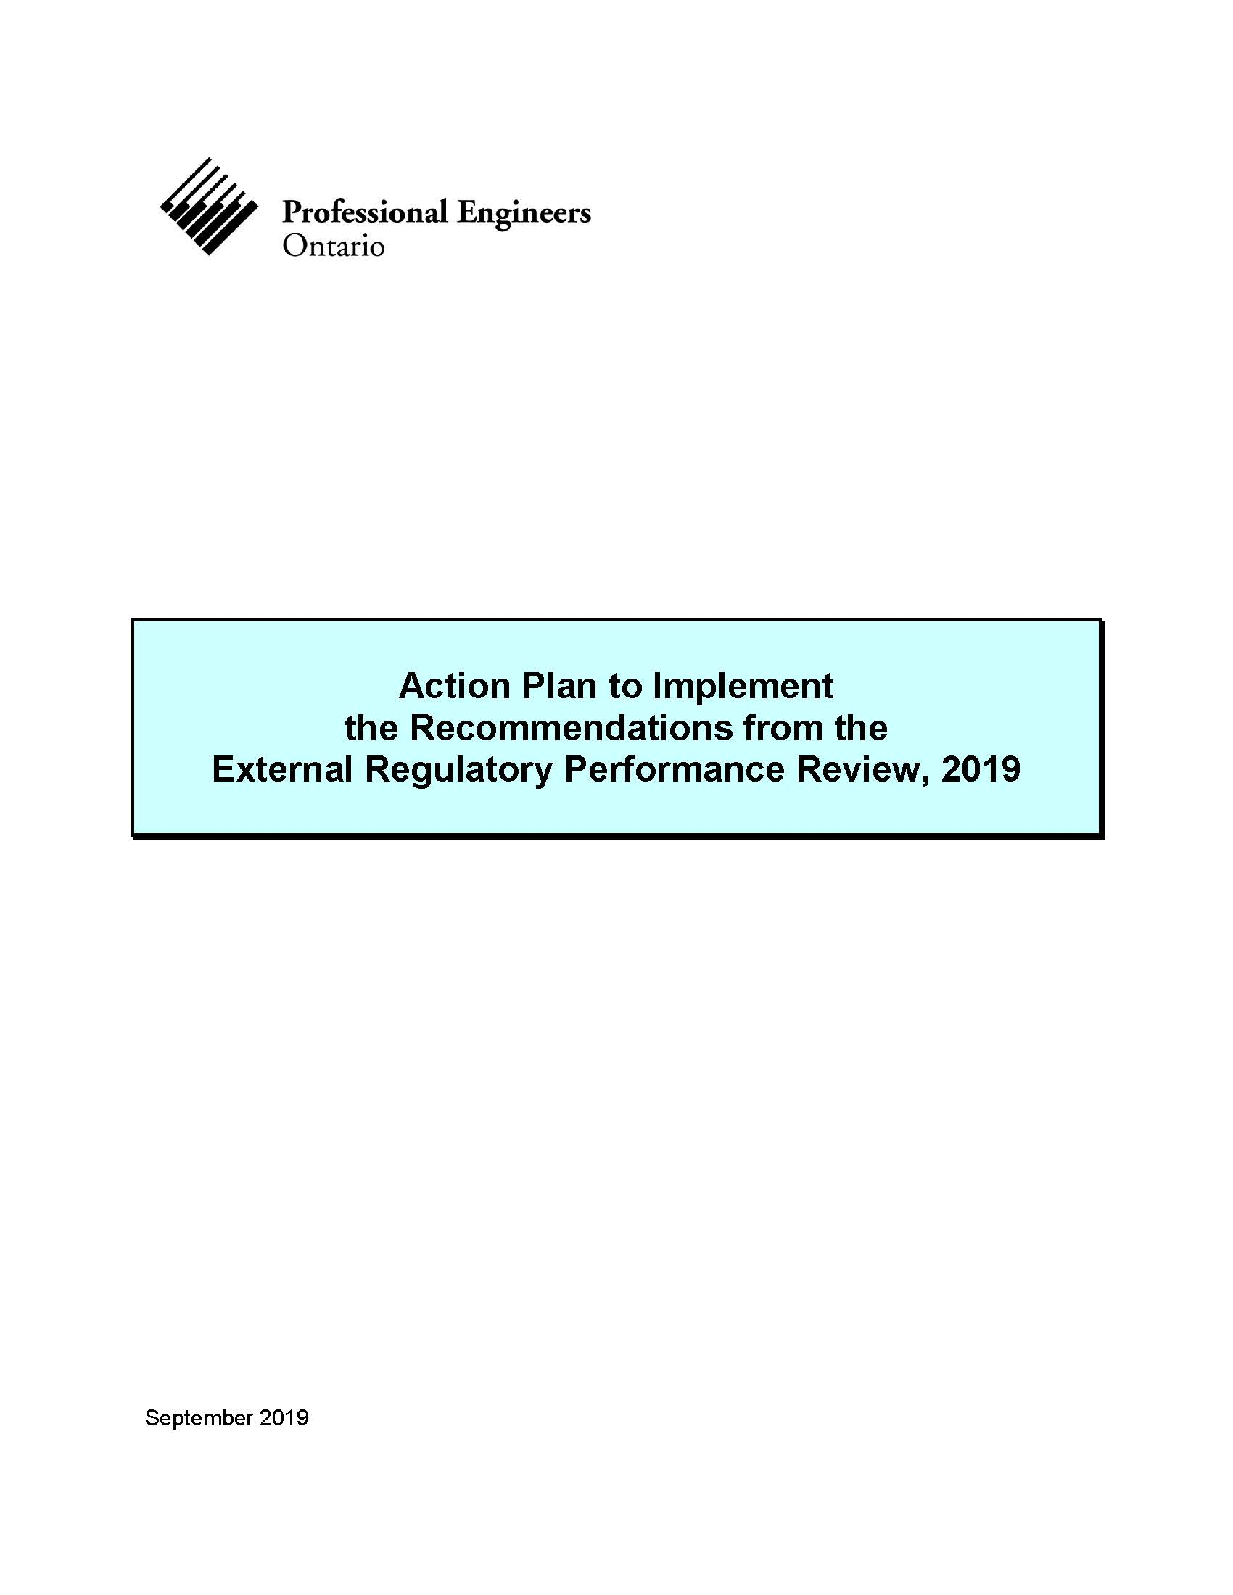
Why External Relations?

Slide 4
Stakeholders
Prelicensing Outreach
Stakeholder Relations
Government Liaison Program
Practice Advisory Services
Strategic Stakeholder Advisory Group
Engaging Stakeholders via External Relations

Slide 5
Policy Development Process
Council
Governance Committees
Policy/Governance Teams
External Relations (Advisory Group + Stakeholder Engagements)

Slide 6
Alignment with PEO’s Strategic Goals
1
Draws new perspectives that align with PEO’s commitment to meaningful stakeholder engagement
3
Equips Council and governance committees with evidence to support informed decision-making
2
Streamlines consultation process to capture feedback and optimize organizational performance
6
Revitalizes PEO’s vision to reaffirm its value and relevance to stakeholders
4

