Slide 1
KEEPING IN TUNE WITH THE VOICES IN THE CHOIR: OUTREACH AND ACCOUNTABILITY BY TRIBUNALS AND REGULATORS Rosemarie McCutcheon, Chair Workplace Safety and Insurance Appeals Tribunal (WSIAT)
Presentation SOAR Conference
November 14, 2024

Slide 2
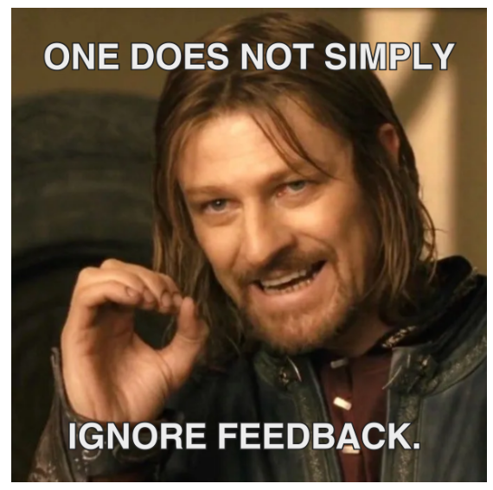

Slide 3
History of outreach and accountability at the wsiat

Slide 4
Early tradition of consultation and outreach
The Tribunal was established in 1985 as the Workers’ Compensation Appeals Tribunal (WCAT): Founding Chair, Dr. S.R. Ellis, KC (Ron Ellis).
The First Annual Report describes consultations between the Chair, the Alternate Chair and a group of representatives of worker and employer constituency organizations called the Advisory Group.
The Advisory Group was a forum where information about the planning for the Tribunal could be shared with major players in various constituencies to keep them apprised of the nature of the plans as they developed and providing an opportunity to provide input.
The advice from the Advisory Group was influential in many of the choices the Tribunal made as it developed its processes and procedures.
The Chair’s commitment to the Advisory Group was to provide full disclosure and to give careful and open-minded consideration to the views expressed at the meetings.
The Tribunal reserved the right to finally make the decisions that would be required.
Notes:
Although provincial systems of workers’ compensation began in 1914 with the Meredith Report, the WCAT was the first independent final level of appeal in workers’ compensation matters

Slide 5
Fast forward to the present: WSIAT consultation policy and advisory group
The WSIAT’s Commitment: to create opportunities for consultation and outreach to promote discussion and knowledge sharing on topics of interest to its stakeholders.
The Advisory Group: a forum where information about the development of the WSIAT and its priorities are shared with major stakeholders in the system.
Mandate: to act as a consultative resource for the WSIAT and to provide the perspective of the respective stakeholder groups on a range of issues as they arise.
Purpose: to foster discussion among different constituents on conceptual and process issues.
Composition: Strive for equal representation from stakeholder organizations and associations from the worker and the employer community.
Notes:
Consultation topics include, but are not limited to:
WSIAT practice and procedure;
WSIAT Practice Directions;
WSIAT forms;
Workplace safety and insurance systemic issues involving WSIAT;
WSIAT’s accessible website;
WSIAT caseload and service-delivery; and
Issues raised by the stakeholders.
Not a forum for the discussion of the merits of individual appeals.
There may also be written requests to the members about matters more appropriate for a written submission.
Generally meets once a year or more frequently, if necessary.
The worker and employer members are representative of the organization or association, rather than individual counsel or representatives.

Slide 6
WSIAT outreach and accountability: by the numbers
Type of Communication | Number
External stakeholder events, 2019 to present | 44 (November 2024 inclusive), 141 (average number of attendees)
Representative Education Program training sessions, 2020 to present | 20 (November 2024 inclusive), 139 (average number of attendees)
External stakeholder communications (e-mail and website), 2019 to present | 108
Meetings and communications with Advisory Group, 2020 to present | 9 Communications, 3 Meetings
Number of decisions published and keyworded since 1985 | 91,911 (to date)

Slide 7
WSIAT Stakeholder surveys and focus groups
2021: Preferred Hearing Format, Access to Justice, and Accessibility Survey
2022: Decision Searching Functionality, Preferred Hearing Format
2022: 7 Focus Groups on Post Pandemic Hearing Formats
Videoconference Teleconference Survey During COVID-19: sent to all representatives who participated in a WSIAT Remote Hearing, starting May 2020
In-Person Hearing Survey: sent to all representatives who participated in a WSIAT in-person hearing starting August 2020
Upcoming
2024 – Accessibility Survey
2024 – Exit Survey

Slide 8
Recent experience with stakeholder outreach and consultation at the wsiat
Consultation on the new pre-hearing process

Slide 9
The goal: launching a new appeal process May 6, 2024
In 2019, the WSIAT began planning the launch of a new pre-hearing process to modernize and achieve more efficient and timely adjudication
Changes included:
Eliminating an outdated process which allowed appeals to remain in “dormant” status for up to 2 years
Updating Practice Directions and Forms to ensure our materials and processes were clear and easy to understand (plain language)
Introducing a Navigator for self-represented parties (soft launch November 2023)
Improving the evidentiary disclosure process
Requiring parties to outline their case earlier in the appeal process
Integrating our processes with electronic communication (E-File/E-Share)
After achieving stabilization following the pandemic, we set a target launch date of November 6, 2023

Slide 10
Advisory group consultation
2022
In 2022, the WSIAT notified the Advisory Group of the plans to implement the new process and provided draft materials for their review
21 Nov. 2022
WSIAT Advisory Group Meeting on November 21, 2022:
There was a lot of feedback
We gave space for voicing concerns
6 Apr. 2023
The Advisory Group met for discussion and the WSIAT team reported on changes made to the proposed process in response to concerns
2023
In 2023, the WSIAT notified the Advisory Group advising that the launch of the new appeal process was moved to the spring of 2024, to allow for more feedback to be provided and implemented into the process before the launch
Aug. 2023
Further written consultation in August 2023 on new WSIAT Practice Directions

Slide 11
Communications and outreach strategy for new appeal process launch
Communications were posted on the WSIAT’s website providing updates, opportunities to attend presentations, ask questions and reminders pertaining to the process on June 20, 2023, August 22, 2023, January 26, 2024, March 8, 2024, April 26, 2024 and May 6, 2024
The WSIAT offered two virtual information sessions about the new process for representatives, parties, and other interested stakeholders prior to the launch of the new appeal process
For changes to our Right to Sue Practice Direction, a notice was posted in the Ontario Reports and presentations were delivered through the Ontario Bar Association to describe the changes
WSIAT’s Director of Appeal Services, Nicole Bisson, delivered multiple outreach presentations to representative groups, the OBA, and at our most recent stakeholder information event on September 17, 2024
Notes:
Nicole Bisson, Director of the Office of the Vice-Chair Registrar (OVCR) delivered outreach presentations on the new process to the OWA, OEA, and 2 of our own stakeholder sessions prior to the launch of the process. A presentation was also delivered in the OBA’s annual update on Workplace Safety and Insurance Law after the process had launched. An update was provided to stakeholders on October 17, 2024 with time to ask questions. The WSIAT continues to take feedback into account of the process.

Slide 12
Key takeaways from consultation process
It was helpful to hear from different groups to see the process and potential challenges from their perspective
Helped us to check our blind spots
A lot of valuable feedback was received
As a result of incorporating many of the suggestions provided, the overall process was improved
Rollout of the new process has been relatively smooth and we achieved buy-in from stakeholders

Slide 13
Remember to listen to the voices in the choir!

